Slide 1

PROJECT NO. 2
PROJECT TITLE:
“ TO IMPROVE THE CUSTOMER SATISFACTION SCORE (C-SAT SCORE) ”
Proprietary and Highly Confidential. 2020 Pursullence Global Business Solutions. All Rights Reserved
Notes:
PROJECT NO. 2 : TOPIC

Slide 2
DEFINE PHASE
Notes:
Project starts with First phase and that is Define Phase.

Slide 3
Scenario:
Mr. Shawn who works for Citizens Bank, The US based bank is the client of Horizon Services. Mr. Vinod Patil is the process owner for insurance consumer service process in Horizon Services. Mr. Shawn informed Mr. Vinod saying “Your service is not meeting the customer satisfaction level as mentioned in SLA. It is affecting my customer retention and I am loosing my customer because of improper customer care service. Please work on improving the customer satisfaction to level as mentioned in SLA or we will discontinue this contract with your company”. Now Mr. Vinod has to work on bringing CSAT level as per to the SLA.
Notes:
Hint: Read the business scenario before proceeding for project

Slide 4
Identification of VOC and Internal -External Customers
Parameters | Identified Area
Voice of Customer | “Your service is not meeting the customer satisfaction level as mentioned in SLA. It is affecting my customer retention and I am loosing my customer because of improper customer care service. Please work on improving the customer satisfaction to level mentioned in SLA or we will discontinue this contract with your company”
External Customer | Mr. Shawn and his Customers
Internal Customer | Mr. Vinod Patil
Critical to Quality | Compliance of CSAT score with SLA Target
Proprietary and Highly Confidential. 2020 Pursullence Global Business Solutions. All Rights Reserved
Notes:
Business Case Premise: Mr. Shawn who works for Citizens Bank, The US based bank is the client of Horizon Services. Mr. Vinod Patil is the process owner for insurance consumer service process in Horizon Services. Mr. Shawn informed Mr. Vinod saying “Your service is not meeting the customer satisfaction level as mentioned in SLA. It is affecting my customer retention and I am loosing my customer because of improper customer care service. Please work on improving the customer satisfaction to level as mentioned in SLA or we will discontinue this contract with your company”. Now Mr. Vinod has to work on bringing CSAT level as per to the SLA.

Slide 5
DATA COLLECTION PLAN
Notes:
Baseline/ Historical Data for Define Phase.

Slide 6
Discrete Data: 1-Proportion Test
Statistical Premise:
To check whether the defined Goal which is obtained from the baseline data is same as that of the goal of population.
Hypothesis
The defined Goal obtained from the baseline data is same as that of the goal of population (p = p_{o})
H_{o}:
H_{a}:
The defined Goal obtained from the baseline data is less than that of the goal of population (p < p_{o})
Proprietary and Highly Confidential. 2020 Pursullence Global Business Solutions. All Rights Reserved
Notes:
Hint
Step 1: Write the purpose of doing one proportion test for validation
Step 2: Write Null and Alternate Hypothesis

Slide 7
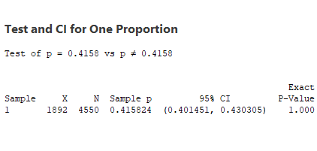
Discrete Data: 1-Proportion Test
Minitab Session Window output:
Interpretation:
Since the p- value is greater than 0.05 (alpha value), we fail to reject null hypothesis and hence, the defined Goal obtained from the baseline data is same as that of the goal of population.
Proprietary and Highly Confidential. 2020 Pursullence Global Business Solutions. All Rights Reserved
Notes:
Hint Cont.…
Step 3: Follow this Minitab Path to get the output : Stat> Basic Statistics> 1-Proportion test and paste the output in the blank space.
Step 4: Write interpretation and conclusion from the P-value.
In proportion test for hypothesized value use 0.4158.
Based on test performed draw the interpretation and conclusion.
The expected p-value from the test performed by you should be 0.988

Slide 8
PROJECT CHARTER

Slide 9
Business Case
Project Scope
In-scope: This project is applicable to service of process 1 of Pune location
Out Scope: This process is inapplicable to locations of Bangalore and Chennai
Mr. Shawn who works for Citizens Bank, The US based bank is the client of Horizon Services. Mr. Vinod Patil is the process owner for insurance consumer service process in Horizon Services. Mr. Shawn informed Mr. Vinod saying “Your service is not meeting the customer satisfaction level as mentioned in SLA. It is affecting my customer retention and I am loosing my customer because of improper customer care service. Please work on improving the customer satisfaction to level mentioned in SLA or we will discontinue this contract with your company”. Now Mr. Vinod has to work on bringing CSAT level at par to the SLA.
QNS
In money
Client retention rate will increase with CSAT
Team Members
Role | Name | Org.
Black Belt/ Manager | Mr. Rajas Badgujar | Silverline Services
MBB/mentor/Sr. Manager | Mr. Rajesh Sabhrawal | Silverline Services
GB | Mr. Mohit Abhyankar | Silverline Services
Core Team | Mr. Suyog Mane, Mr. Abhay Chaddha | Silverline Services
Process Owner/ Champion | Mr. Vinod Patil | Silverline Services
SME | Mr. Nikhil Shah | Silverline Services
Finance | Ms. Hitesh Joshi | Silverline Services
Problem Statement
Out of 4550 CSAT readings of historical data collection, CSAT score for 2658 readings is lower than target CSAT score of 3. It means that process has not met the CSAT target for 58% of the readings, which is severe !
Project Timeline
Goal Statement
Phase | Start Date | End Date
Define | 1st January, 2020 | 31st March 2020
Measure | 1st April 2020 | 30th April 2020
Analyze | 1^{sh} May 2020 | 17th May 2020
Improve | 17th May 2020 | 15th June 2020
Control | 16th June 2020 | 30th July 2020
To meet client expectations by increasing CSAT score - DPMO from xxxxx to yyyyyy by July'20.
Proprietary and Highly Confidential. 2020 Pursullence Global Business Solutions. All Rights Reserved
Notes:
Use the following statement as business case:
Hints for Problem Statement:
Go through historical data
Find the average CSAT score in excel
Client has informed that there has to be minimum 3 as CSAT Score.
Please check and count the number of transactions that are less than 3 (Count the number of transactions with CSAT below 3.
Find the percentage of low CSAT.
Percentage of data point are below SLA
This will help you to find problem statement.
*Please refer our previous project to understand how problem statement is written.
Goal Statement:
Please prepare your ‘time binding’ statement based on improving current average to client expected CSAT score i.e. 3
Refer our previous project
In-scope/Out-scope
This project is conducted for process 1. Although it runs in location of Bangalore and Chennai, but this project will be applicable only for process 1 of Pune location.

Slide 10
SIPOC
SUPPLIER
INPUT
PROCESS
OUTPUT
CUSTOMER
Customer Care Service
SLA Agreement
Laptop
Process Individuals
Contact arrives at Agent Desk
If it is not an issue, determine appropriate routing and approve transfer
If it is an issue, research & rerate issue and support issue resolution
Resolve issue and notify customer
Approve escalation and report
Customer rate on their experience
Review weekly case
Approved Transfer
Resolved Issue
Customer seeking experience
Customer rating based on their experience
Proprietary and Highly Confidential. 2020 Pursullence Global Business Solutions. All Rights Reserved
Notes:
Hint:
Please refer process map given in next step (slide 10) and draw a high level process step.
Also refer our training manual and other project as a reference to identify each of the component of SIPOC
Insert the text box for each column to insert the answer.

Slide 11

Process Map:
Quality - Help Desk Process Map
Click here
Notes:
Hint:
Please refer the attached excel file for reference and clear view of process map
Observe the process map given and try to understand the flow of work.

Slide 12
COMMUNICATION PLAN (RACI MATRIX)
RACI | RESPONSIBLE PERSON | NAME OF PERSON
Responsible | Green Belt | Mr. Mohit Abhyaknar
Approval | Manager | Mr. Rajas Badgujar
Consult | Sr. Manager | Mr. Rajesh Sabhrawal
Inform | Process Owner/MBB | Mr. Rajesh Sabhrawal & Mr. Vinod Patil
Review | RESPONSIBLE PERSON | NAME OF PERSON
Weekly | Responsible, Approval | Mr. Mohit Abhyaknar & Mr. Rajas Badgujar
Fortnightly | Responsible, Approval & Consult | Mr. Mohit Abhyaknar, Mr. Rajas Badgujar & Mr. Rajesh Sabhrawal
Monthly/Tollgate | Responsible, Approval, Consult & Inform | Mr. Mohit Abhyaknar, Mr. Rajas Badgujar, Mr. Rajesh Sabhrawal Mr. Vinod Patil
Notes:
Hint:
Please refer the TAT project for communication plan construction.
Take team members reference and their designation from project charter of this project to construct the matrix. (Slide 8)

Slide 13
MEASURE PHASE
Proprietary and Highly Confidential. 2020 Pursullence Global Business Solutions. All Rights Reserved

Slide 14
Operational Definition
CSAT score is the performance rating given by the end user for
respective query based on satisfactory resolution of the same.
Performance Standards
Unit Of Measure (UOM)
Every single query that receives CSAT score.
CSAT Score Given By Customer For Resolved Query
Opportunity
Every single query that receives CSAT score.
Data (Y) - Discrete
Data Source
System/(Helpdesk Ticketing tool)
Specification Limits & Target Value
USL – NA Target- 3
LSL –
1) Less than 3 ( for CSAT per customer query )
2) Less than 2.5 ( for Avg. CSAT score per Day )
Defective Definition:
Any query which has CSAT score < 3.
Proprietary and Highly Confidential. 2020 Pursullence Global Business Solutions. All Rights Reserved
Notes:
NOTE:- Performance Standards are already prepared and provided for your reference.

Slide 15
MEASUREMENT SYSTEM ANALYSIS
As Data Is Collected From System I.E. Data Is Generated From Helpdesk Ticketing Tool, So There Is No Need To Perform MSA
Proprietary and Highly Confidential. 2020 Pursullence Global Business Solutions. All Rights Reserved
Notes:
NOTE:- In this case there is no need to perform MSA as data collected is system driven.

Slide 16
List of Potential Causes
SR NO | 13CAUSES
1 | Shifts
2 | Unplanned call fluctuations
3 | Employee
4 | Educational background
5 | Gender
6 | Experience
7 | Calls Take Longer Than Expected
8 | Long after call work (wrap-up) time
9 | Server down issues
10 | Lack of knowledge to resolve
11 | Lack of confidence
12 | TL
SR NO | CAUSES
13 | % Of Rework Incidences In Given Day (% Of Total Rework Incidences / Total Requests Processed)
14 | Unscheduled meeting on given day
15 | % Unplanned leaves on given day
16 | Query Handling time (IN HRS)
17 | Unscheduled meeting on given day
18 | Handling multiple task
19 | % Unplanned leaves on given day
20 | No. Of rework incidences in given day
21 | Technical System issue
22 | Unwillingness to work
21 | Technical System issue
22 | Unwillingness to work
Proprietary and Highly Confidential. 2020 Pursullence Global Business Solutions. All Rights Reserved
Notes:
NOTE :- Given List of Potential Causes are obtained from Brainstorming sessions that were conducted during measure phase along with SME’s, Process Manager which are already provided for your reference.

Slide 17
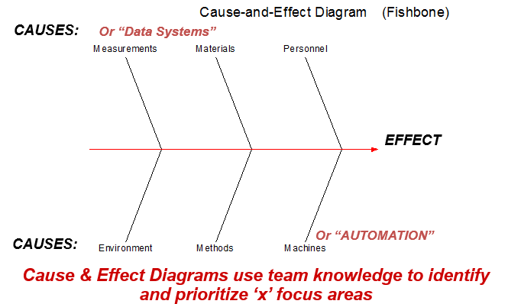
Ishikawa / Fishbone/ Cause & Effect Diagram
Unscheduled meeting on given day
Lack of confidence
Educational background
Employee
Lack of knowledge to resolve
% Unplanned leaves on given day
Experience
Unwillingness to work
% Of Rework Incidences
Gender
TL
)
CSAT Score
Shifts
Calls Take Longer
Than Expected
Query Handling time
Server down issues
Technical System issue
Long after call work
(wrap-up) time
Handling multiple task
Unplanned call fluctuations
Proprietary and Highly Confidential. 2020 Pursullence Global Business Solutions. All Rights Reserved
Notes:
HINT:-
Refer to slide ‘List of potential causes’.
From the available list of potential causes, segregate those causes into the categories of Fishbone diagram.
Categorize those causes into current slide of Fishbone diagram.
Note :- For eg- Education background is into personal category . Similarly do the remaining causes segregation.

Slide 18
C-I MATRIX
SR NO | CAUSES | TYPE
 |  | CONTROLLABLE/ NON CONTROLLABLE | HIGH/LOW IMPACTABLE | MEASUREABLE/NON-MEASUREABLE
1 | DAY OF WEEK | CONTROLLABLE | HIGH IMPACTABLE | MEASUREABLE
2 | EMPLOYEE | NON CONTROLLABLE | LOW IMPACTABLE | MEASUREABLE
3 | SHIFTS | CONTROLLABLE | HIGH IMPACTABLE | MEASUREABLE
4 | TYPES OF TASK COMPLEXITY | CONTROLLABLE | HIGH IMPACTABLE | MEASUREABLE
5 | EDUCATIONAL BACKGROUND | CONTROLLABLE | HIGH IMPACTABLE | MEASUREABLE
6 | EXPERIENCE | CONTROLLABLE | HIGH IMPACTABLE | MEASUREABLE
7 | QUERY HOLDING TIME | CONTROLLABLE | HIGH IMPACTABLE | MEASUREABLE
8 | GENDER | CONTROLLABLE | LOW IMPACTABLE | NON-MEASUREABLE
9 | TL | NON CONTROLLABLE | LOW IMPACTABLE | NON-MEASUREABLE
10 | QUERY HANDLING TIME | CONTROLLABLE | HIGH IMPACTABLE | MEASUREABLE
11 | NO. OF REWORK INCIDENCES IN GIVEN DAY | NON CONTROLLABLE | HIGH IMPACTABLE | NON-MEASUREABLE
12 | HANDLING MULTIPLE TASK | CONTROLLABLE | HIGH IMPACTABLE | MEASUREABLE
Proprietary and Highly Confidential. 2020 Pursullence Global Business Solutions. All Rights Reserved
Notes:
NOTE:- C- I matrix is already prepared and provided for your reference.

Slide 19
SAMPLING PLAN
Types of Sampling used :-
Random Sampling
In random sampling each sample has equal probability of chosen from population.
Stratified Sampling
It is a powerful sampling technique that allows sampled data to be separated into ‘subgroups’ called “strata”
Proprietary and Highly Confidential. 2020 Pursullence Global Business Solutions. All Rights Reserved
Notes:
NOTE:- Sampling Plan is already provided for your reference.

Slide 20
Data Collection Plan
CONTROLLABLE / NON CONTROLLABLE |  |  | OPERATIONAL DEFINATION | SAMPLING PLAN
What To Measure | Y Or X | Data Type | Operational Definition | What | Where | When | How Many
CSAT Score (Y) | Y | Discrete | CSAT score is the performance rating given by the end user for respective query based on satisfactory resolution of the same. | Collect database for CSAT score tickets. | Ticketing Tool, Excel database | 02/03/2020 to 27/03/2020 | Minimum 20 samples
Gender | X | Discrete | Which Gender (Male ,Female)
Experience/Tenure | X | Discrete | Which Tenure level
Team Lead | X | Discrete | Which TL (name wise- TL1, TL2)
Day of Week | X | Discrete | For Which day( Monday- Friday)
Shifts of Day | X | Discrete | For Which Shift (Morning, Afternoon, Night)
Educational Background (G/PG) | X | Discrete | Educational background (G/PG)
Proprietary and Highly Confidential. 2020 Pursullence Global Business Solutions. All Rights Reserved
Notes:
NOTE:- Data Collection Plan is already prepared and provided for your reference for both Y & X’s.

Slide 21
Data Collection Plan
CONTROLLABLE / NON CONTROLLABLE |  |  | OPERATIONAL DEFINATION | SAMPLING PLAN
What To Measure | Y Or X | Data Type | Operational Definition | What | Where | When | How Many
Query Holding time | X | Discrete | System generated hold time data | Collect database for CSAT score tickets. | Ticketing Tool, Excel database | 02/03/2020 to 27/03/2020 | Minimum 20 samples
Query Handling time | X | Discrete | System generated hold time data
Employee | X | Discrete | Name of employees
No. Of Rework Incidences In Given Day | X | Discrete | No of rework incidences per day
Handling Multiple Task | X | Discrete | No of multiple tasks handled per day
Proprietary and Highly Confidential. 2020 Pursullence Global Business Solutions. All Rights Reserved
Notes:
NOTE:- Data Collection Plan is already prepared and provided for your reference for both Y & X’s.

Slide 22
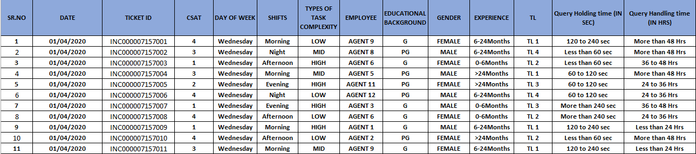
Measure Phase Data Collection in Excel – Part 1
Proprietary and Highly Confidential. 2020 Pursullence Global Business Solutions. All Rights Reserved
Notes:
Note:- Excel sheet data (Data 1) is embedded into slide for your reference

Slide 23
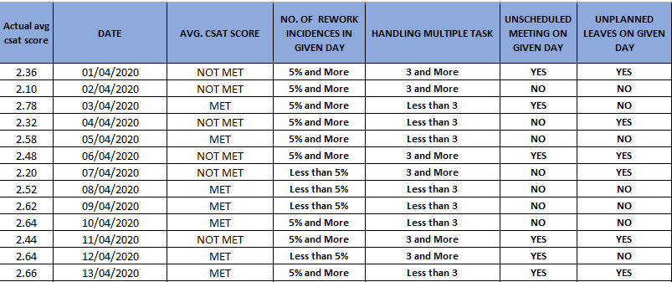
Measure Phase Data Collection in Excel – Part 2
Proprietary and Highly Confidential. 2020 Pursullence Global Business Solutions. All Rights Reserved
Notes:
Note:- Excel sheet data (data 2) is embedded into slide for your reference

Slide 24
CAPABILITY ANALYSIS-SIGMA VALUE CALCULATION
For Continuous Data: For Discrete Data:
FORMULA
FORMULA
LONG TERM SIGMA VALUE =
LONG TERM SIGMA VALUE =
NORMSINV(1-DPO)
NORMSINV(1-DPO)
SHORT TERM SIGMA VALUE =
LONG TERM VALUE + 1.5
Note: if the spec limit is an UPPER spec, the numerator is USL – Mean (or Target);
if the spec limit is a LOWER spec, the numerator is Mean (or Target) - LSL
Proprietary and Highly Confidential. 2020 Pursullence Global Business Solutions. All Rights Reserved
Notes:
Note:- CAPABILITY ANALYSIS-SIGMA VALUE CALCULATION
Formulas are already provided for your reference

Slide 25
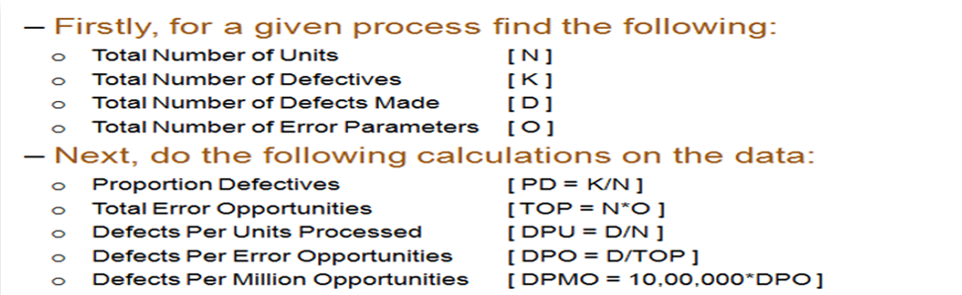
DETERMINE PROCESS CAPABILITY- DPMO
DPMO – Defects per million opportunities
For Sigma Value use Excel formula:
LONG TERM SIGMA VALUE (ZLT) | ZLT= normsinv( 1- DPO)
SHORT TERM SIGMA VALUE (ZST) | ZST= ZLT +1.5
Proprietary and Highly Confidential. 2020 Pursullence Global Business Solutions. All Rights Reserved
Notes:
DPMO CALCULATION :-
Formulas are already provided for your reference.
Y is discrete. Which sigma value will you select ( Long Term or Short Term) ?
Highlight that sigma value in red color on this slide.

Slide 26
CAPABILITY ANALYSIS
DEFECTIVE DEFINITION | CSAT score <3
TOTAL UNITS ( HINT: Take count of CSAT data from measure phase) | 1500
TOTAL OPPORTUNITIES ( HINT: Here defectives & opportunities are same) | 1500
DEFECTIVE ( HINT: How many defectives from CSAT data in measure phase are not meeting target <3 CSAT score.) | 740
DEFECTS/DEFECTIVES PER OPPORTUNITIES ( HINT: Using DPO formula calculate DPO value) | 0.4933
DEFECTIVES PER MILLION OPPORTUNITIES ( HINT: Using DPMO formula calculate value ) | 493333.33
LONG TERM SIGMA VALUE (ZLT) ( HINT: Use formula :- normsinv( 1- DPO) | 0.0167
SHORT TERM SIGMA VALUE (ZST) ( HINT: N/A) | NA
Proprietary and Highly Confidential. 2020 Pursullence Global Business Solutions. All Rights Reserved
Notes:
HINT:-
Refer to the DPMO formulas & find the appropriate values of parameters of capability analysis.
2) CAPABILITY ANALYSIS: Solutions for Capability analysis are displayed in hint section.
1) Defective Definition - CSAT Score <3
2) Total Units - 1500
3) Total Opportunities - 1500
4) Defective - 740
5) Defects/Defectives Per Opportunities - 0.49333
6) Defectives Per Million Opportunities - 493333.33
7) LONG TERM SIGMA VALUE (ZLT) = normsinv ( 1- DPO) = 0.016

Slide 27
ANALYZE PHASE

Slide 28
GRAPHICAL ANALYSIS
Proprietary and Highly Confidential. 2020 Pursullence Global Business Solutions. All Rights Reserved

Slide 29
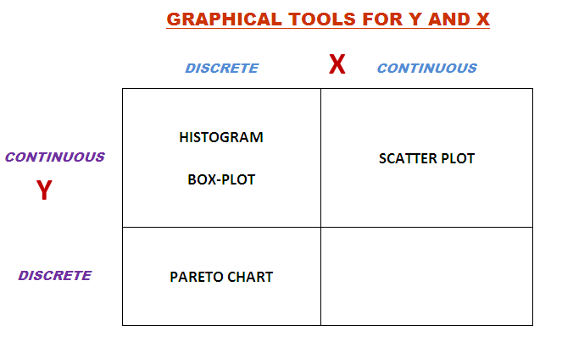
Summary chart for reference
Notes:
Hint: Please use the above table to understand which graph can implemented based on the type of data.

Slide 30
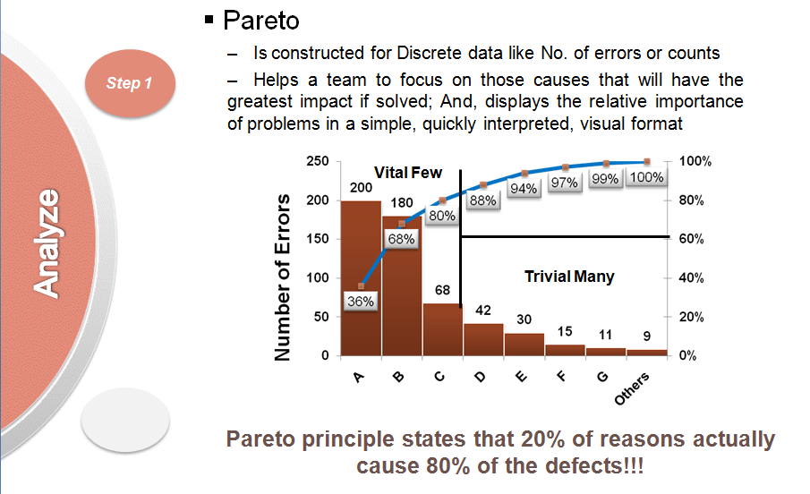
Pareto Tests
Is constructed for Discrete data like No. of errors or counts
Helps a team to focus on those causes that will have the greatest impact if solved; And, displays the relative importance of problems in a simple, quickly interpreted, visual format.
Proprietary and Highly Confidential. 2020 Pursullence Global Business Solutions. All Rights Reserved
Notes:
Hint:- Pareto Chart description is already provided for your reference.

Slide 31
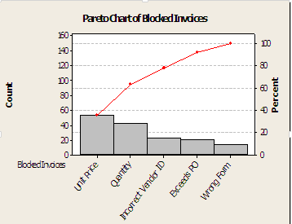
Pareto
SAMPLE GRAPH:
Discrete data
Categorize defects
Summarize defect counts
Application:
Advantages:
Can use text or numerical data as input
Creates prioritized bar chart
Cumulative percentage line (red) shows the added contribution of each category
Disadvantages:
None – this is the primary graphical tool for discrete data
Proprietary and Highly Confidential. 2020 Pursullence Global Business Solutions. All Rights Reserved
Notes:
Hint :- Pareto Chart description is already provided for your reference.

Slide 32
Pareto Chart
Output:- Pareto Chart of ‘SHIFTS’ by ‘CSAT Score’
Interpretation:
Here from this Pareto Chart, we can observe that all Shifts have almost same incidences of not meeting minimum CSAT score
Proprietary and Highly Confidential. 2020 Pursullence Global Business Solutions. All Rights Reserved
Notes:
Hint:
Step 1: Follow this Minitab Path to get the output : Stat->Quality Tools –> Pareto Chart
Step 2: Write interpretation by reading the chart

Slide 33
Pareto Chart
Output:- Pareto Chart of ‘Day of the week’ by ‘CSAT Score’
Interpretation:
Here from this Pareto Chart, we can observe that Wednesday has more incidences of not meeting target CSAT score
Proprietary and Highly Confidential. 2020 Pursullence Global Business Solutions. All Rights Reserved
Notes:
Hint:
Step 1: Select the data and perform the pareto test by referring the steps done to get pareto chart as done in previous slide.
Step 2: Follow this Minitab Path to get the output : Stat->Quality Tools –> Pareto Chart
Step 3: Paste the pareto chart in the given box and write interpretation by reading the chart

Slide 34
Pareto Chart
Output:- Pareto Chart of ‘Educational Background’ by ‘CSAT Score’
Interpretation:
Here from this Pareto Chart, we can observe that people with graduation Educational Background have more incidences of not meeting target CSAT score
Proprietary and Highly Confidential. 2020 Pursullence Global Business Solutions. All Rights Reserved
Notes:
Hint:
Step 1: Select the data and perform the pareto test by referring the steps done to get pareto chart as done in previous slide.
Step 2: Follow this Minitab Path to get the output : Stat->Quality Tools –> Pareto Chart
Step 3: Paste the pareto chart in the given box and write interpretation by reading the chart

Slide 35
Pareto Chart
Output:- Pareto Chart of ‘Gender’ by ‘CSAT Score’
Interpretation:
Here from this Pareto Chart, we can observe that Male employees have more incidences of not meeting target CSAT score
Proprietary and Highly Confidential. 2020 Pursullence Global Business Solutions. All Rights Reserved
Notes:
Hint:
Step 1: Select the data and perform the pareto test by referring the steps done to get pareto chart as done in previous slide.
Step 2: Follow this Minitab Path to get the output : Stat->Quality Tools –> Pareto Chart
Step 3: Paste the pareto chart in the given box and write interpretation by reading the chart

Slide 36
Pareto Chart
Output:- Pareto Chart of ‘Experience’ by ‘CSAT Score’
Interpretation:
Here from this Pareto Chart, we can observe that Experience (6-24) months has more incidences of not meeting target CSAT score
Proprietary and Highly Confidential. 2020 Pursullence Global Business Solutions. All Rights Reserved
Notes:
Hint:
Step 1: Select the data and perform the pareto test by referring the steps done to get pareto chart as done in previous slide.
Step 2: Follow this Minitab Path to get the output : Stat->Quality Tools –> Pareto Chart
Step 3: Paste the pareto chart in the given box and write interpretation by reading the chart

Slide 37
Pareto Chart
Output:- Pareto Chart of ‘TL’ by ‘CSAT Score’
Interpretation:
Here from this Pareto Chart, we can observe that all Team Leads have almost same incidences of not meeting target CSAT score
Proprietary and Highly Confidential. 2020 Pursullence Global Business Solutions. All Rights Reserved
Notes:
Hint:
Step 1: Select the data and perform the pareto test by referring the steps done to get pareto chart as done in previous slide.
Step 2: Follow this Minitab Path to get the output : Stat->Quality Tools –> Pareto Chart
Step 3: Paste the pareto chart in the given box and write interpretation by reading the chart

Slide 38
Pareto Chart
Output:- Pareto Chart of ‘Task Complexity’ by ‘CSAT Score’
Interpretation:
Here from this Pareto Chart, we can observe that Type of Complexity (High) have more incidences of not meeting target CSAT score
Proprietary and Highly Confidential. 2020 Pursullence Global Business Solutions. All Rights Reserved
Notes:
Hint:
Step 1: Select the data and perform the pareto test by referring the steps done to get pareto chart as done in previous slide.
Step 2: Follow this Minitab Path to get the output : Stat->Quality Tools –> Pareto Chart
Step 3: Paste the pareto chart in the given box and write interpretation by reading the chart

Slide 39
Pareto Chart
Output:- Pareto Chart of ‘Query Holding time (IN SEC)’ by ‘CSAT Score’
Interpretation:
Here from this Pareto Chart, we can observe that Query Holding Time (IN SEC) of More than 240 sec has more incidences of not meeting target CSAT score
Proprietary and Highly Confidential. 2020 Pursullence Global Business Solutions. All Rights Reserved
Notes:
Hint:
Step 1: Select the data and perform the pareto test by referring the steps done to get pareto chart as done in previous slide.
Step 2: Follow this Minitab Path to get the output : Stat->Quality Tools –> Pareto Chart
Step 3: Paste the pareto chart in the given box and write interpretation by reading the chart

Slide 40
Pareto Chart
Output:- Pareto Chart of ‘Query Holding time (IN HRS)’ by ‘CSAT Score’
Interpretation:
Here from this Pareto Chart, we can observe that all Query Holding time (IN HRS) have same incidences of not meeting target CSAT score
Proprietary and Highly Confidential. 2020 Pursullence Global Business Solutions. All Rights Reserved
Notes:
Hint:
Step 1: Select the data and perform the pareto test by referring the steps done to get pareto chart as done in previous slide.
Step 2: Follow this Minitab Path to get the output : Stat->Quality Tools –> Pareto Chart
Step 3: Paste the pareto chart in the given box and write interpretation by reading the chart

Slide 41
INFERENTIAL TEST
Proprietary and Highly Confidential. 2020 Pursullence Global Business Solutions. All Rights Reserved

Slide 42
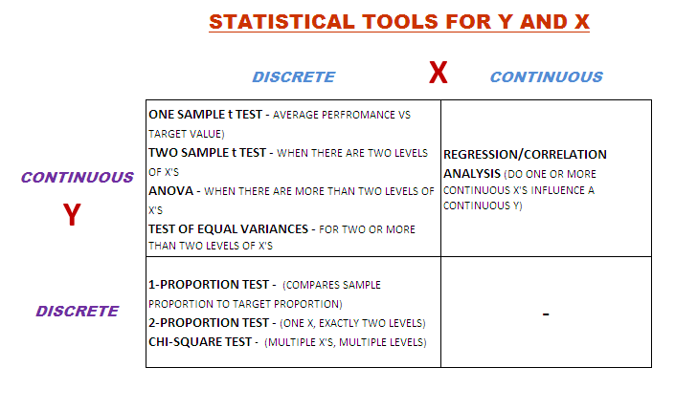
Summary chart for reference
Notes:
Statistical tool selection guide for your reference.

Slide 43
Statistical Tools Selection and expected results
For CSAT value in rating between 1-5
Y (PROBLEM) | X (CAUSES) | DESCRIPTIVE TEST | INFERENTIAL TEST | EXPECTED P-VALUE | POST HOC TEST | SIGNIFICANT SUB-CAUSE (OBSERVED VALUE>EXPECTED VALUE)
CSAT | DAY OF WEEK | PARETO | CHI-SQUARE TEST | 0.964 | NOT APPLICABLE | -
CSAT | SHIFT | PARETO | CHI-SQUARE TEST | 0.738 | NOT APPLICABLE | -
CSAT | TYPES OF TASK COMPLEXITY | PARETO | CHI-SQUARE TEST | 0 | GOODNESS OF FIT | LOW
CSAT | EDUCATIONAL BACKGROUND | PARETO | CHI-SQUARE TEST | 0.647 | NOT APPLICABLE
CSAT | GENDER | PARETO | CHI-SQUARE TEST | 0.332 | NOT APPLICABLE
CSAT | EXPERIENCE | PARETO | CHI-SQUARE TEST | 0 | GOODNESS OF FIT | 6-24 MONTHS
CSAT | TEAM LEAD | PARETO | CHI-SQUARE TEST | 0.738 | NOT APPLICABLE
CSAT | QUERY HOLDING TIME (IN SEC) | PARETO | CHI-SQUARE TEST | 0 | GOODNESS OF FIT | LESS THAN 60 SEC
CSAT | QUERY HOLDING TIME (IN HR) | PARETO | CHI-SQUARE TEST | 0.007 | GOODNESS OF FIT | 24-36 HRS
Proprietary and Highly Confidential. 2020 Pursullence Global Business Solutions. All Rights Reserved
Notes:
Hint:
Before proceeding kindly read the above table understand the steps to be followed.
How to read the table:
Column 1: Name of Y (Problem)
Column 2: Name of X (Causes)
Column 3: Based on Y data type and X data type the descriptive test that is to be performed is mentioned
Column 4: Based on Y data type and X data type the inferential test that is to be performed is mentioned
Column 5: After performing the test, this column gives hint of respective p-value of ‘x’
Column 6: Now if p-value is less than 0.05 the cause is significant, so if it is true then this column tell whether post hoc test is applicable or not.
Column 7: If post hoc test is performed then which sub cause of significant cause has more impact is shown here. (Note: If the Observed value > Expected Value then that sub cause is significant.)

Slide 44
Chi-Square Test
When is a Chi-Square (χ²) Test Used?
A Chi-Square Test compares the proportion of discrete ‘y’ responses for multiple ‘level’s of an ‘x’
The Chi-Square Test answers the question: It is observed in graphical analysis that proportions of ‘Y’ across sub-categories of ‘X’ are not same.
Is above result occurred, statistically significant enough i.e. applicable to whole population ? or,
ii. Is above result occurred by just random chance i.e. applicable only to current sample of ‘Y’?
H_{o} : The proportions of ‘Y’ across sub-categories of ‘X’ are same i.e. X has no impact on Y.
H_{a} : The proportions of ‘Y’ across sub-categories of ‘X’ are not same i.e. X has impact on Y.
Note: Chi-Square Tests can be used for ‘x’s with 2 OR MORE levels
Proprietary and Highly Confidential. 2020 Pursullence Global Business Solutions. All Rights Reserved
Notes:
Chi Square test theory.

Slide 45
Chi Square Test for ‘Day of week’
HYPOTHETICAL PREMISE
Purpose:
To check whether the result of Pareto chart of ‘Day of Week’ by CSAT score was statistically significant or occurred by random chance
HYPOTHESIS:
H_{o}:
H_{a}:
The observation of CSAT score (Met & Not Met), are same across Days of week
The observation of CSAT score (Met & Not Met), are not same across Days of week
Proprietary and Highly Confidential. 2020 Pursullence Global Business Solutions. All Rights Reserved
Notes:
Steps to perform Chi Square Test:
Step 1: Write the purpose of doing Chi Square test for validation
Step 2: Write Null and Alternate Hypothesis

Slide 46
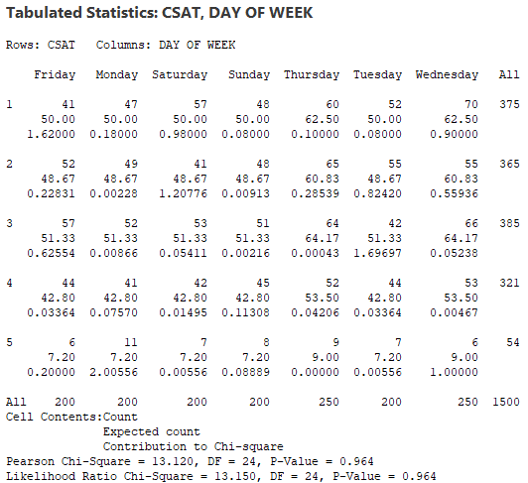
Output of Chi-Square Test for ‘Day of the week’
Minitab Session Window output:
Interpretation:
Since p-value is more than 0.05, we fail to reject null hypothesis. Hence, we can conclude that there is no impact of “Day of Week” on CSAT score.
Proprietary and Highly Confidential. 2020 Pursullence Global Business Solutions. All Rights Reserved
Notes:
Step 3 Follow this Minitab Path to get the output : Stat -->Tables --> Cross Tabulation and Chi Squared Test and paste the output in the blank space.
Step 4: Write interpretation and conclusion from the P-value.

Slide 47
Chi Square Test for type of ‘Task complexity’
HYPOTHETICAL PREMISE
Purpose:
To check whether the result of Pareto chart of ‘Task Complexity’ by CSAT score was statistically significant or occurred by random chance
HYPOTHESIS:
H_{o}: The observation of CSAT score (Met & Not Met), are same across Task Complexity
H_{a}: The observation of CSAT score (Met & Not Met), are not across same Task Complexity
Proprietary and Highly Confidential. 2020 Pursullence Global Business Solutions. All Rights Reserved
Notes:
Steps to perform Chi Square Test:
Step 1: Write the purpose of doing Chi Square test for validation
Step 2: Write Null and Alternate Hypothesis

Slide 48
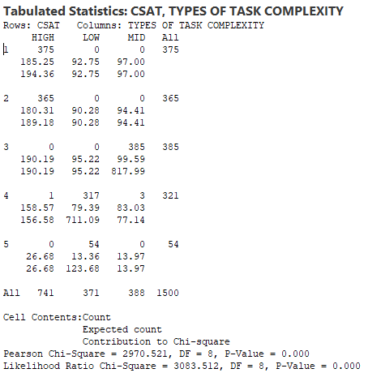
Output of Chi-Square Test for ‘Task complexity’
Minitab Session Window output:
Interpretation:
Since p-value is less than 0.05, we reject null hypothesis. Hence, we can conclude that impact of “Types of Task Complexity” on CSAT score is statistically significant.
Proprietary and Highly Confidential. 2020 Pursullence Global Business Solutions. All Rights Reserved
Notes:
Step 1: Follow this Minitab Path to get the output : Stat -->Tables --> Cross Tabulation and Chi Squared Test and paste the output in the blank space.
Step 2: Write interpretation and conclusion from the P-value.

Slide 49
Chi Square Test for ‘Educational background’
HYPOTHETICAL PREMISE
Purpose:
To check whether the result of Pareto chart of ‘Educational Background’ by CSAT score was statistically significant or occurred by random chance
HYPOTHESIS:
H_{o}: The observation of CSAT score (Met & Not Met), are same across Educational Background
H_{a}: The observation of CSAT score (Met & Not Met), are not same across Educational Background
Proprietary and Highly Confidential. 2020 Pursullence Global Business Solutions. All Rights Reserved
Notes:
Steps to perform Chi Square Test:
Step 1: Write the purpose of doing Chi Square test for validation
Step 2: Write Null and Alternate Hypothesis

Slide 50
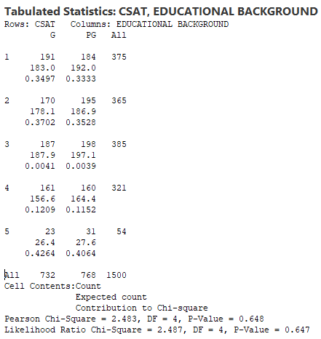
Output of Chi-Square Test for ‘Educational background’
Minitab Session Window output:
Interpretation:
Since p-value is more than 0.05, we fail to reject null hypothesis. Hence, we can conclude that there is no impact of “Educational Background” on CSAT score.
Proprietary and Highly Confidential. 2020 Pursullence Global Business Solutions. All Rights Reserved
Notes:
Step 1: Follow this Minitab Path to get the output : Stat -->Tables --> Cross Tabulation and Chi Squared Test and paste the output in the blank space.
Step 2: Write interpretation and conclusion from the P-value.

Slide 51
Chi Square Test for ‘Gender’
HYPOTHETICAL PREMISE
Purpose:
To check whether the result of Pareto chart ‘Gender’ by CSAT score was statistically significant or occurred by random chance
HYPOTHESIS:
H_{o}: The observation of CSAT score (Met & Not Met), are same across Gender
H_{a}: The observation of CSAT score (Met & Not Met), are not same across Gender
Proprietary and Highly Confidential. 2020 Pursullence Global Business Solutions. All Rights Reserved
Notes:
Steps to perform Chi Square Test:
Step 1: Write the purpose of doing Chi Square test for validation
Step 2: Write Null and Alternate Hypothesis

Slide 52
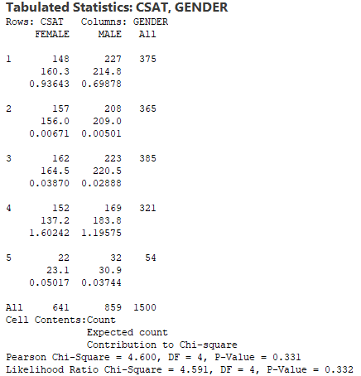
Output of Chi-Square Test for ‘Gender’
Minitab Session Window output:
Interpretation:
Since p-value is more than 0.05, we fail to reject null hypothesis. Hence, we can conclude that there is no impact of “Gender” on CSAT score.
Proprietary and Highly Confidential. 2020 Pursullence Global Business Solutions. All Rights Reserved
Notes:
Step 1: Follow this Minitab Path to get the output : Stat -->Tables --> Cross Tabulation and Chi Squared Test and paste the output in the blank space.
Step 2: Write interpretation and conclusion from the P-value.

Slide 53
Chi Square Test for ‘Experience’
HYPOTHETICAL PREMISE
Purpose:
To check whether the result of Pareto chart ‘Experience’ by CSAT score was statistically significant or occurred by random chance
HYPOTHESIS:
H_{o}: The observation of CSAT score (Met & Not Met), are same across Experience
H_{a}: The observation of CSAT score (Met & Not Met), are not same across Experience
Proprietary and Highly Confidential. 2020 Pursullence Global Business Solutions. All Rights Reserved
Notes:
Steps to perform Chi Square Test:
Step 1: Write the purpose of doing Chi Square test for validation
Step 2: Write Null and Alternate Hypothesis

Slide 54
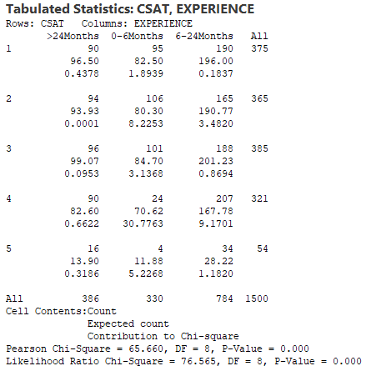
Output of Chi-Square Test ‘Experience’
Minitab Session Window output:
Interpretation:
Since p-value is less than 0.05, we reject null hypothesis. Hence, we can conclude that impact of “Experience” on CSAT score is statistically significant.
Proprietary and Highly Confidential. 2020 Pursullence Global Business Solutions. All Rights Reserved
Notes:
Step 1: Follow this Minitab Path to get the output : Stat -->Tables --> Cross Tabulation and Chi Squared Test and paste the output in the blank space.
Step 2: Write interpretation and conclusion from the P-value.

Slide 55
Chi Square Test for ‘TL’
HYPOTHETICAL PREMISE
Purpose:
To check whether the result of Pareto chart ‘TL’ by CSAT score was statistically significant or occurred by random chance
HYPOTHESIS:
H_{o}: The observation of CSAT score (Met & Not Met), are same across TL
H_{a}: The observation of CSAT score (Met & Not Met), are not same across TL
Proprietary and Highly Confidential. 2020 Pursullence Global Business Solutions. All Rights Reserved
Notes:
Steps to perform Chi Square Test:
Step 1: Write the purpose of doing Chi Square test for validation
Step 2: Write Null and Alternate Hypothesis

Slide 56
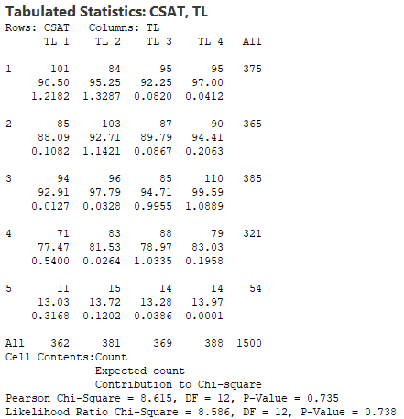
Output of Chi-Square Test ‘TL’
Minitab Session Window output:
Interpretation:
Since p-value is more than 0.05, we fail to reject null hypothesis. Hence, we can conclude that there is no impact of “TL” on CSAT score.
Proprietary and Highly Confidential. 2020 Pursullence Global Business Solutions. All Rights Reserved
Notes:
Step 1: Follow this Minitab Path to get the output : Stat -->Tables --> Cross Tabulation and Chi Squared Test and paste the output in the blank space.
Step 2: Write interpretation and conclusion from the P-value.

Slide 57
Chi Square Test for
‘Query Holding time (IN SEC)’
HYPOTHETICAL PREMISE
Purpose:
To check whether the result of Pareto chart ‘Query Holding Time (IN SEC)’ by CSAT score was statistically significant or occurred by random chance
HYPOTHESIS:
H_{o}: The observation of CSAT score (Met & Not Met), are not same across Query Holding Time (IN SEC)
H_{a}: The observation of CSAT score (Met & Not Met), are not same across Query Holding Time (IN SEC)
Proprietary and Highly Confidential. 2020 Pursullence Global Business Solutions. All Rights Reserved
Notes:
Steps to perform Chi Square Test:
Step 1: Write the purpose of doing Chi Square test for validation
Step 2: Write Null and Alternate Hypothesis

Slide 58
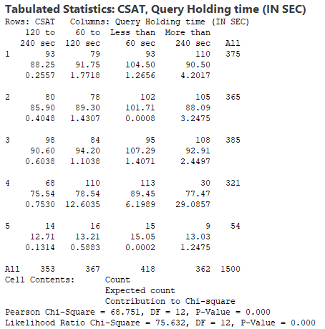
Output of Chi-Square Test for
‘Query Holding time (IN SEC)’
Minitab Session Window output:
Interpretation:
Since p-value is less than 0.05, we reject null hypothesis. Hence, we can conclude that impact of “Experience” on CSAT score is statistically significant.
Proprietary and Highly Confidential. 2020 Pursullence Global Business Solutions. All Rights Reserved
Notes:
Step 1: Follow this Minitab Path to get the output : Stat -->Tables --> Cross Tabulation and Chi Squared Test and paste the output in the blank space.
Step 2: Write interpretation and conclusion from the P-value.

Slide 59
Chi Square Test for
‘Query Holding time (IN HRS)’
HYPOTHETICAL PREMISE
Purpose:
To check whether the result of Pareto chart ‘Query Holding Time (IN HRS)’ by CSAT score was statistically significant or occurred by random chance
HYPOTHESIS:
H_{o}: The observation of CSAT score (Met & Not Met), are same across Query Holding Time (IN HRS)
H_{a}: The observation of CSAT score (Met & Not Met), are not same across Query Holding Time (IN HRS)
Proprietary and Highly Confidential. 2020 Pursullence Global Business Solutions. All Rights Reserved
Notes:
Steps to perform Chi Square Test:
Step 1: Write the purpose of doing Chi Square test for validation
Step 2: Write Null and Alternate Hypothesis

Slide 60
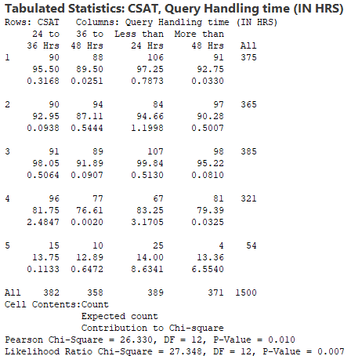
Output of Chi-Square Test for
‘Query Holding time (IN HRS)’
Minitab Session Window output:
Interpretation:
Since p-value is less than 0.05, we reject null hypothesis. Hence, we can conclude that impact of “Query Holding Time (IN HRS) on CSAT score is statistically significant.
Proprietary and Highly Confidential. 2020 Pursullence Global Business Solutions. All Rights Reserved
Notes:
Step 1: Follow this Minitab Path to get the output : Stat -->Tables --> Cross Tabulation and Chi Squared Test and paste the output in the blank space.
Step 2: Write interpretation and conclusion from the P-value.

Slide 61
Chi-Square Tests Goodness of fit
When is a Chi-Square (χ²) Goodness of fit Test Used ?
When one find positive result for chi square test, ie.when p value < 0.05, it indicates that an Impact of “ X” on “Y” is statistically significant. Then, one need to find out which sublevel of “X” has significant impact on “Y”.
Chi-Square (χ²) Goodness of fit Test validate which sublevel of X has significant impact upon Y.
Proprietary and Highly Confidential. 2020 Pursullence Global Business Solutions. All Rights Reserved
Notes:
Chi square test goodness of fit theory for your reference.

Slide 62
Graphical Output of Goodness of Fit Test for
‘Type of Task Complexity’
Minitab Session Window output:
Interpretation:
Since Observed Value > Expected Value, and P-Value < 0.05 (alpha value) we reject null hypothesis, thus we can conclude that “Low” Task complexity has significant impact on CSAT Score.
Proprietary and Highly Confidential. 2020 Pursullence Global Business Solutions. All Rights Reserved
Notes:
Hint:
Steps to get Observed & Expected Frequency graph of Goodness of fit test:
Step 1: Follow this Minitab Path to get the output : Stat ->Tables -> Chi-Square Goodness of fit test and paste the Observed & Expected Frequency graph in the blank space.
Step 2: Write interpretation from the Graph.

Slide 63
Graphical Output of Goodness of Fit Test for
for ‘Experience’
Minitab Session Window output:
Interpretation:
Since Observed Value > Expected Value, and P-Value < 0.05 (alpha value) we reject null hypothesis, thus we can conclude that “6-24 Months” of Experience has significant impact on CSAT Score.
Proprietary and Highly Confidential. 2020 Pursullence Global Business Solutions. All Rights Reserved
Notes:
Hint:
Steps to get Observed & Expected Frequency graph of Goodness of fit test:
Step 1: Follow this Minitab Path to get the output : Stat ->Tables -> Chi-Square Goodness of fit test and paste the Observed & Expected Frequency graph in the blank space.
Step 2: Write interpretation from the Graph.

Slide 64
Graphical Output of Goodness of Fit Test for
‘Query Holding time (IN SEC)’
Minitab Session Window output:
Interpretation:
Since Observed Value > Expected Value, and P-Value < 0.05 (alpha value) we reject null hypothesis, thus we can conclude that “Less than 60 sec” of Query Holding time (in sec) has significant impact on CSAT Score.
Proprietary and Highly Confidential. 2020 Pursullence Global Business Solutions. All Rights Reserved
Notes:
Hint:
Steps to get Observed & Expected Frequency graph of Goodness of fit test:
Step 1: Follow this Minitab Path to get the output : Stat ->Tables -> Chi-Square Goodness of fit test and paste the Observed & Expected Frequency graph in the blank space.
Step 2: Write interpretation from the Graph.

Slide 65
Graphical Output of Goodness of Fit Test for
‘Query Holding time (IN HRS)’
Minitab Session Window output:
Interpretation:
Since Observed Value > Expected Value, and P-Value < 0.05 (alpha value) we reject null hypothesis, thus we can conclude that “Less than 60 sec” of Query Holding time (in sec) has significant impact on CSAT Score.
Proprietary and Highly Confidential. 2020 Pursullence Global Business Solutions. All Rights Reserved
Notes:
Hint:
Steps to get Observed & Expected Frequency graph of Goodness of fit test:
Step 1: Follow this Minitab Path to get the output : Stat ->Tables -> Chi-Square Goodness of fit test and paste the Observed & Expected Frequency graph in the blank space.
Step 2: Write interpretation from the Graph.

Slide 66
GRAPHICAL TOOLS FOR Y & X
Proprietary and Highly Confidential. 2020 Pursullence Global Business Solutions. All Rights Reserved
Notes:
Hint:-
Graphical Tools table for Y & X type of data is already provided for your reference.

Slide 67
Pareto Chart
Output:- Pareto Chart of ‘CSAT Score’ by ‘ NO. OF REWORK INCIDENCES IN GIVEN DAY’
Interpretation:
Here from this Pareto Chart, we can observe that 5% and More No. of Rework Incidences in a given day has more incidences of not meeting target CSAT score
Proprietary and Highly Confidential. 2020 Pursullence Global Business Solutions. All Rights Reserved
Notes:
Hint:-
Steps to perform Pareto chart
Step 1: Follow this Minitab Path to get the output : Stat> Quality Tools> Pareto Chart
Step 2: Paste the output of Pareto chart from minitab in the blank space.
Step 3: Write interpretation from pareto chart.

Slide 68
Pareto Chart
Output:- Pareto Chart of ‘CSAT Score’ by ‘HANDLING MULTIPLE TASK’
Interpretation:
Here from this Pareto Chart, we can observe that Handling Multiple Task of 3 and More has more incidences of not meeting target CSAT score
Proprietary and Highly Confidential. 2020 Pursullence Global Business Solutions. All Rights Reserved
Notes:
Hint:-
Steps to perform Pareto chart
Step 1: Follow this Minitab Path to get the output : Stat> Quality Tools> Pareto Chart
Step 2: Paste the output of Pareto chart from minitab in the blank space.
Step 3: Write interpretation from for pareto chart.

Slide 69
Pareto Chart
Output:- Pareto Chart of ‘CSAT Score’ by ‘UNSCHEDULED MEETING ON GIVEN DAY’
Interpretation:
Here from this Pareto Chart, we can observe that Having and not Having an Unscheduled Meeting on given day have same incidences of not meeting target CSAT score
Proprietary and Highly Confidential. 2020 Pursullence Global Business Solutions. All Rights Reserved
Notes:
Hint:-
Steps to perform Pareto chart
Step 1: Follow this Minitab Path to get the output : Stat> Quality Tools> Pareto Chart
Step 2: Paste the output of Pareto chart from minitab in the blank space.
Step 3: Write interpretation from pareto chart.

Slide 70
Pareto Chart
Output:- Pareto Chart of ‘CSAT Score’ by ‘ % UNPLANNED LEAVES ON GIVEN DAY’
Interpretation:
Here from this Pareto Chart, we can observe that Unplanned Leaves on a given day has more incidences of not meeting target CSAT score
Proprietary and Highly Confidential. 2020 Pursullence Global Business Solutions. All Rights Reserved
Notes:
Hint:-
Steps to perform Pareto chart
Step 1: Follow this Minitab Path to get the output : Stat> Quality Tools> Pareto Chart
Step 2: Paste the output of Pareto chart from minitab in the blank space.
Step 3: Write interpretation from pareto chart.

Slide 71
STATISTICAL TEST TABLE FOR Y& X TYPE OF DATA
Proprietary and Highly Confidential. 2020 Pursullence Global Business Solutions. All Rights Reserved
Notes:
Hint:-
Statistical test table for Y & X type of data is already provided for your reference.

Slide 72
2-Proportion Test
When is a 2-Proportion Test Used?
A 2-Proportion Test compares the proportion of discrete ‘y’ for two ‘level’s of an ‘x’. Difference between Chi Square test and 2 proportion test is- whenever there are more than 2 levels / categories of Xs, we will use Chi Square test. And, whenever 2 levels / categories of Xs, we will use 2 proportion test.
The 2-Proportion Test answers the question: It is observed in graphical analysis that proportions of ‘Y’ across 2 sub-categories of ‘X’ are not same.
Is above observation statistically significant enough i.e. applicable to whole population ? or,
ii. Is above observation occurred by random chance i.e. applicable only to random sample of ‘Y’?
Hypothesis:
H_{o} : The proportions of ‘Y’ across 2 sub-categories of ‘X’ are same i.e. X has no impact on Y
H_{a} : The proportions of ‘Y’ across 2 sub-categories of ‘X’ are not same. i.e. X has impact on Y
Proprietary and Highly Confidential. 2020 Pursullence Global Business Solutions. All Rights Reserved
Notes:
2 Proportion test theory for your reference.

Slide 73
2 PROPORTION TEST FOR ‘NO. OF REWORK INCIDENCES / DAY’
HYPOTHETICAL PREMISE
Purpose:
To check whether the result of Pareto chart ‘No. of Rework Incidences’ by Avg. CSAT score was statistically significant or occurred by random chance
Hypothesis:
H_{o}: The observation of Avg. CSAT score (Met & Not Met), are same across No. of Rework Incidences
H_{a}: The observation of Avg. CSAT score (Met & Not Met), are not same across No. of Rework Incidences
Proprietary and Highly Confidential. 2020 Pursullence Global Business Solutions. All Rights Reserved
Notes:
Hint:-
Steps to perform 2 P Test :-
Step 1: Follow this Minitab Path to get the output : Stat> Basic Statistics> 2-Proportion test
Step 2: Write Purpose of 2P test.
Step 3: Write Ho & Ha hypothesis

Slide 74
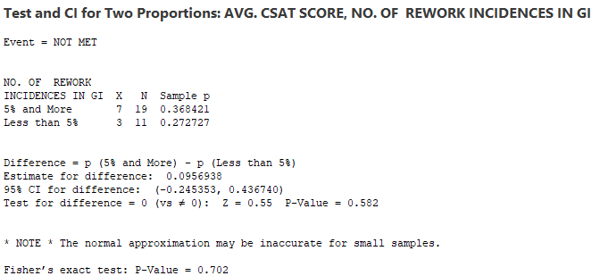
Output of 2 P Test For ‘No. Of Rework Incidences/Day’
Minitab Session Window output:
Interpretation:
Since p-value is more than 0.05, we fail to reject null hypothesis. Hence, we can conclude that there is no impact of “No. of Rework Incidences” on Avg. CSAT score.
Proprietary and Highly Confidential. 2020 Pursullence Global Business Solutions. All Rights Reserved
Notes:
Hint :-
Step 1: Paste output of 2 P test obtained from minitab in the blank space.
Step 2: Write interpretation and conclusion from the P-value.

Slide 75
2 PROPORTION TEST FOR ‘HANDLING MULTIPLE TASK’
HYPOTHETICAL PREMISE
Purpose:
To check whether the result of Pareto chart ‘Handling Multiple Task’ by Avg. CSAT score was statistically significant or occurred by random chance
Hypothesis:
H_{o}: The observation of Avg. CSAT score (Met & Not Met), are same across Handling Multiple Task
H_{a}: The observation of Avg. CSAT score (Met & Not Met), are not same across Handling Multiple Task
Proprietary and Highly Confidential. 2020 Pursullence Global Business Solutions. All Rights Reserved
Notes:
Hint :-
Steps to perform 2 P Test :-
Step 1: Follow this Minitab Path to get the output : Stat> Basic Statistics> 2-Proportion test
Step 2: Write Purpose of 2P test.
Step 3: Write Ho & Ha hypothesis

Slide 76
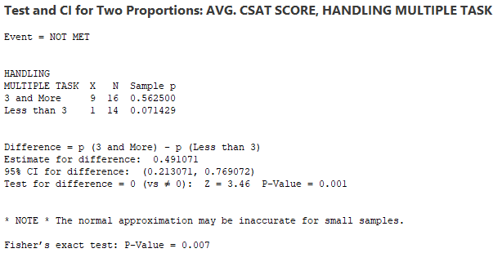
Output of 2 P Test For ‘HANDLING MULTIPLE TASK’
Minitab Session Window output:
Interpretation:
Since p-value is less than 0.05, we reject null hypothesis. Hence, we can conclude that impact of “Handling Multiple Task” on Avg. CSAT score is statistically significant.
Proprietary and Highly Confidential. 2020 Pursullence Global Business Solutions. All Rights Reserved
Notes:
Hint:-
Step 1: Paste output of 2 P test obtained from minitab in the blank space.
Step 2: Write interpretation and conclusion from the P-value.

Slide 77
2 PROPORTION TEST FOR ‘UNSCHEDULED MEETING ON GIVEN DAY’
HYPOTHETICAL PREMISE
Purpose:
To check whether the result of Pareto chart ‘Unscheduled Meeting on given day’ by Avg. CSAT score was statistically significant or occurred by random chance
Hypothesis:
H_{o}: The observation of Avg. CSAT score (Met & Not Met), are same across Unscheduled Meeting on given day
H_{a}: The observation of Avg. CSAT score (Met & Not Met), are not same across Unscheduled Meeting on given day
Proprietary and Highly Confidential. 2020 Pursullence Global Business Solutions. All Rights Reserved
Notes:
Hint:-
Steps to perform 2 P Test :-
Step 1: Follow this Minitab Path to get the output : Stat> Basic Statistics> 2-Proportion test
Step 2: Write Purpose of 2P test.
Step 3: Write Ho & Ha hypothesis

Slide 78
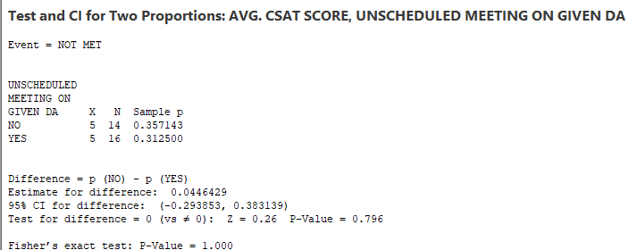
Output of 2 P Test For ‘UNSCHEDULED MEETING ON GIVEN DAY’
Minitab Session Window output:
Interpretation:
Since p-value is more than 0.05, we fail to reject null hypothesis. Hence, we can conclude that there is no impact of “Unscheduled Meeting on given day” on Avg. CSAT score.
Proprietary and Highly Confidential. 2020 Pursullence Global Business Solutions. All Rights Reserved
Notes:
Hint:-
Step 1: Paste output of 2 P test obtained from minitab in the blank space.
Step 2: Write interpretation and conclusion from the P-value.

Slide 79
2 PROPORTION TEST FOR ‘% UNPLANNED LEAVES ON GIVEN DAY’
HYPOTHETICAL PREMISE
Purpose:
To check whether the result of Pareto chart ‘% Unplanned Leaves on given day’ by Avg. CSAT score was statistically significant or occurred by random chance
Hypothesis:
H_{o}: The observation of Avg. CSAT score (Met & Not Met), are same across % Unplanned Leaves on Given Day
H_{a}: The observation of Avg. CSAT score (Met & Not Met), are not same across % Unplanned Leaves on Given Day
Proprietary and Highly Confidential. 2020 Pursullence Global Business Solutions. All Rights Reserved
Notes:
Hint:-
Steps to perform 2 P Test :-
Step 1: Follow this Minitab Path to get the output : Stat> Basic Statistics> 2-Proportion test
Step 2: Write Purpose of 2P test.
Step 3: Write Ho & Ha hypothesis

Slide 80
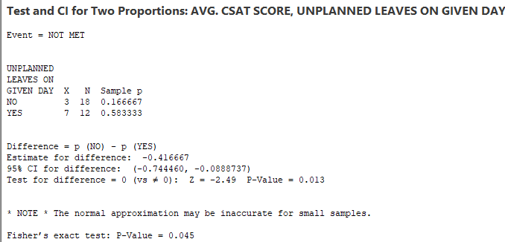
Output of 2 P Test For ‘% UNPLANNED LEAVES ON GIVEN DAY’
Minitab Session Window output:
Interpretation:
Since p-value is less than 0.05, we reject null hypothesis. Hence, we can conclude that impact of “% Unplanned Leaves on given day” on Avg. CSAT score is statistically significant.
Proprietary and Highly Confidential. 2020 Pursullence Global Business Solutions. All Rights Reserved
Notes:
Hint:-
Step 1: Paste output of 2 P test obtained from minitab in the blank space.
Step 2: Write interpretation and conclusion from the P-value.

Slide 81
SUMMARY TABLE
Statistical Tools Selection and expected results
Y (PROBLEM) | X (CAUSES) | DESCRIPTIVE TEST | INFERENTIAL TEST | EXPPECTED P-VALUE | POST HOC TEST | SIGNIFICANT SUBCAUSE (OBSERVED >EXPECTED)
CSAT | NO. OF REWORK INCIDENCES IN GIVEN DAY | PARETO | TWO PROPORTION TEST | 0.582 | NOT APPLICABLE | -
CSAT | HANDLING MULTIPLE TASK | PARETO | TWO PROPORTION TEST | 0.007 | GOODNESS OF FIT | 3 & MORE
CSAT | UNSCHEDULED MEETING ON GIVEN DAY | PARETO | TWO PROPORTION TEST | 0.796 | NOT APPLICABLE | -
CSAT | % UNPLANNED LEAVES ON GIVEN DAY | PARETO | TWO PROPORTION TEST | 0.01 | GOODNESS OF FIT | YES
Proprietary and Highly Confidential. 2020 Pursullence Global Business Solutions. All Rights Reserved
Notes:
Hint:-
Final Summary table is already provided for Y (CSAT) & X’s.

Slide 82
IMPROVE PHASE
Proprietary and Highly Confidential. 2020 Pursullence Global Business Solutions. All Rights Reserved

Slide 83
Solution Brainstorming
SR. NO | Significant X’s | Solutions 1 | Solutions 2 | Solutions 3 | Solutions 4
1 | Type of task complexity | Analyze past 3 months task distribution and increase high complex task distribution to experienced members by 20-30% over next3 weeks.
2 | Employee Experience /Tenure | Arrange a meeting with mid experienced staff and discuss their challenges and best practices with them and incorporate adequate best practices. | Arrange refresh training sessions for mid experienced professionals. | Develop and improvement plan for consistent low performers | Standardize technicians / engineers performance with frequent online tests every week that ensure employee know details of the process and error patterns. And map their performance with appraisals.
3 | Query Holding time (IN SEC) | Manage the calls in proper way.
Proprietary and Highly Confidential. 2020 Pursullence Global Business Solutions. All Rights Reserved
Notes:
Note: Solution Brainstorming is done by Pursullence.

Slide 84
Solution Brainstorming- Continued
SR. NO | Significant X’s | Solutions 1 | Solutions 2 | Solutions 3 | Solutions 4
4 | Query Handling time (IN HRS) | Get Proper understanding of whole the process.it helps to reduce the query handling time.
5 | Handling Multiple Task | Conduct a task handling assessment for next 3-4 days with few case staff from exp /mid exp/ freshers and understand time consumption patterns across volume driven (actual tasks), trigger driven(meetings driven) and % time consumptions on work on total time spent in office. | Ensure task switching reduces by 20-30% at fresher's level by ensuring minimal task switching for fresher's as low as 1 task a day.
6 | % Unplanned Leaves On Given Day | Analyze unplanned leaves pattern restructure appraisal policy with negative points on unplanned leaves. | Encourage team planned leaves before time.
Proprietary and Highly Confidential. 2020 Pursullence Global Business Solutions. All Rights Reserved
Notes:
Note: Solution Brainstorming is done by Pursullence.

Slide 85
Solution Refining
Significant | Ideas | Impact | Low Cost | Feasible to Deploy | Authority Consent | Solutions Priority Index
Xs
1. Type of task complexity | Analyze past 3 months task distribution and increase high complex task distribution to experienced members by 20-30% over next3 weeks. | 3 | 3 | 3 | 3 | 81
2. Employee Experience /Tenure | Arrange a meeting with mid experienced staff and discuss their challenges and best practices with them and incorporate adequate best practices. | 3 | 3 | 3 | 3 | 81
 | Arrange refresh training sessions for mid experienced professionals. | 3 | 2 | 3 | 2 | 36
 | Develop an improvement plan for consistent low performers | 3 | 3 | 2 | 3 | 54
 | Standardize technicians / engineers performance with frequent online tests every week that ensure employee know details of the process and error patterns. And map their performance with appraisals. | 3 | 2 | 2 | 3 | 36
3. Query Holding time (IN SEC) | Develop personal performance tracker for bottom 20% performers. | 3 | 3 | 3 | 3 | 81
Proprietary and Highly Confidential. 2020 Pursullence Global Business Solutions. All Rights Reserved
Notes:
Note: Solution Refining is done by Pursullence.

Slide 86
Solution Refining- Continued
Significant | Ideas | Impact | Low Cost | Feasible to Deploy | Authority Consent | Solutions Priority Index
Xs
4. Query Handling time (IN HRS) | Arrange monthly training program. | 3 | 3 | 3 | 3 | 81
 | Develop personal performance tracker for bottom 20% performers. | 3 | 3 | 3 | 3 | 81
5. Handling Multiple Task | Conduct a task handling assessment for next 3-4 days with few trial case staff from exp/mid exp / freshers and understand time consumption patterns across volume driven (actual tasks), trigger driven(meetings driven) and % time consumptions on work on total time spent in office. | 3 | 2 | 2 | 3 | 36
 | Ensure task switching reduces by 20-30% at freshers level by ensuring minimal task switching for freshers as low as 1 task a day. | 3 | 3 | 3 | 3 | 81
6. % Unplanned leaves | Analyse unplanned leaves pattern restructure appraisal policy with negative points on unplanned leaves. | 3 | 3 | 3 | 3 | 81
 | Encourage team planned leaves before time. | 3 | 3 | 3 | 3 | 81
Proprietary and Highly Confidential. 2020 Pursullence Global Business Solutions. All Rights Reserved
Notes:
Note: Solution Refining is done by Pursullence.

Slide 87
Pilot Phase Planning and Data Collection
PHASE I : SOLUTIONS SENSITIZATION ( 1stMay 2020 to 10th May 2020)
From process 1 of Account 1 of Horizon Services, bottom 10% resources are planned to analyze based on historical data. Pilot project will be implemented upon bottom 10% performers from each experience tenure level.
Project problem will be discussed with them, important causes and probable solutions need to be communicated to them in a small session. Probable challenges to implement solutions will be discussed and 10 days timeline from 1stMay 2020 to 10th May 2020 will be allocated for solutions sensitization.
Process TL will track the challenges to deploy solutions and best practices sharing on daily basis.
LSSGB project leader and AM will review solution implementation status on alternate days and ensure smooth implementation of solutions and will provide adequate support.
PHASE II : ASSESSMENT OF SOLUTION STANDARDIZATION : ( 11th May 2020 to 12th May 2020)
1. On 11th May 2020, a small test will be conducted among pilot participants to assess their understanding of new changes or solutions. If test will assure that > 90% participants’ scores are satisfactory, then we will confirm that solution standardization is accomplished. Update will be communicated to authorities/process owner.
PHASE III : IMPROVE PHASE DATA COLLECTION AND IMPROVEMENT VALIDATION : (17th May, 2020 until 30th June 2020 )
Improve phase data collection will commence from Monday, 17th May, 2020 until 30th June 2020 . If Improvement will be achieved, it will be validated based on adequate statistical tests and capability analysis. Results will be shared with authorities and improvement will be assessed monetarily.
Proprietary and Highly Confidential. 2020 Pursullence Global Business Solutions. All Rights Reserved
Notes:
Note: Pilot Phase Planning and Data Collection is done by Pursullence.

Slide 88
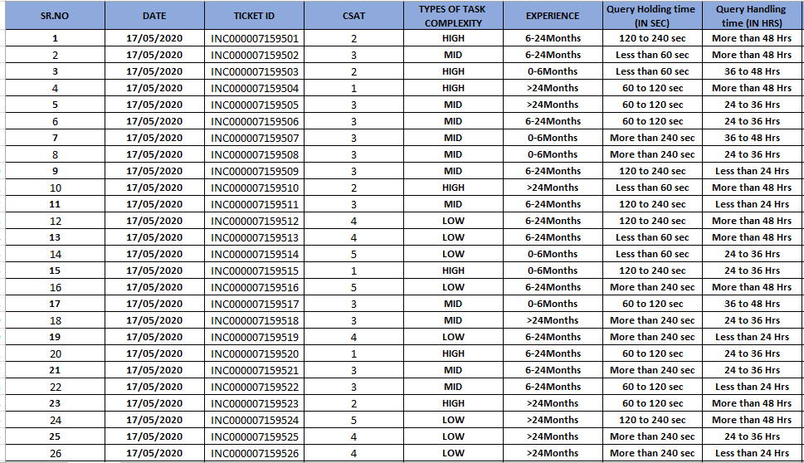
Improve Phase: Data Collection
Proprietary and Highly Confidential. 2020 Pursullence Global Business Solutions. All Rights Reserved
Notes:
Hint: Here we provide the data collection sheet in excel format. Here we collect data for significant X’s and Y i.e. CSAT score.

Slide 89
Validation Test – 2 Proportion Test
Purpose:
To check whether the improvement is accomplished in improve phase
Hypothesis
H_{o} : The proportion of CSAT score in Improve phase is same as the proportion of CSAT score in Measure Phase (p₁ = p₂).
H_{a} : The proportion of CSAT score in Improve phase is more than the proportion of CSAT score in Measure Phase (p₁ < p₂).
Proprietary and Highly Confidential. 2020 Pursullence Global Business Solutions. All Rights Reserved
Notes:
Steps to perform 2 proportion test:
Step 1: Write the purpose of doing 2 proportion test for validation (For this, you can refer TAT project)
Step 2: Write Null and Alternate Hypothesis.

Slide 90
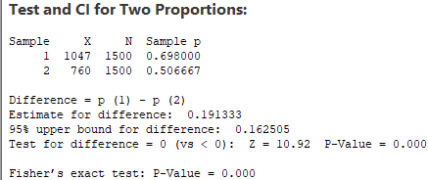
Validation Test – 2 Proportion Test
Minitab Output:
Interpretation: Since the p- value is less than 0.05 (alpha value), we reject null hypothesis and hence, the proportion of CSAT Score in control phase is more than the proportion of % TAT Compliance in Measure Phase.
Conclusion: Since the p- value is less than 0.05 (alpha value), we can conclude improvement in CSAT Score is sustained.
Proprietary and Highly Confidential. 2020 Pursullence Global Business Solutions. All Rights Reserved
Notes:
Steps to perform 2 proportion test continued:
Step 3: Follow this Minitab Path to get the output : Stat> Basic Statistics> 2-Proportion test and paste the output in the blank space.
Step 4: Write interpretation and conclusion from the P-value.
Hint:
The expected p-value from the test performed by you should be 0.000

Slide 91
Validation Test – 1 Proportion Test
Purpose:
To validate whether the defined Goal is met and applicable for total population in improve phase.
Hypothesis
H_{o} : The proportion of CSAT Score in improve phase is same as the target proportion (p = p_{o})
H_{a} : The proportion of CSAT Score in improve phase is less than the target proportion (p < p_{o})
Proprietary and Highly Confidential. 2020 Pursullence Global Business Solutions. All Rights Reserved
Notes:
Steps to perform 1 proportion test:
Step 1: Write the purpose of doing one proportion test for validation (For this, you can refer TAT project)
Step 2: Write Null and Alternate Hypothesis.

Slide 92
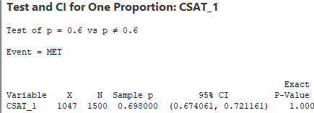
Validation Test – 1 Proportion Test
Minitab Output:
Interpretation: Since the p- value is greater than 0.05 (alpha value), we fail to reject Ho, hence the proportion of CSAT Score in improve phase is same as the target proportion.
Conclusion: Since p- value is > of 0.05 (alpha value), we can conclude that proportion of CSAT Score is achieved set target (i.e. 60%). Hence we can infer that improvement goal is accomplished in improve phase.
Proprietary and Highly Confidential. 2020 Pursullence Global Business Solutions. All Rights Reserved
Notes:
Steps to perform 1 proportion test continued:
Step 3: Follow this Minitab Path to get the output : Stat> Basic Statistics> 1-Proportion test and paste the output in the blank space.
Step 4: Write interpretation and conclusion from the P-value.
Hint:
In control phase for 1 proportion test use 0.60 as hypothesized value.
The expected p-value from the test performed by you should be 1.000

Slide 93
Capability Test
Summary Table:
DEFECTIVE DEFINITION | CSAT Score <3
TOTAL UNITS ( HINT: Take count of CSAT data from improve phase) | 1500
TOTAL OPPORTUNITIES (HINT: Here defectives & opportunities are same) | 1500
DEFECTIVE ( HINT: How many defectives from CSAT data in improve phase are not meeting target <3 CSAT score.) | 453
DEFECTS/DEFECTIVES PER OPPORTUNITIES (HINT: Using DPO formula calculate DPO value) | 0.302
DEFECTIVES PER MILLION OPPORTUNITIES ( HINT: Using DPMO formula calculate value ) | 302000
LONG TERM SIGMA VALUE (ZLT) (HINT: Use formula :- normsinv( 1- DPO) | 0.518
SHORT TERM SIGMA VALUE (ZST) (HINT: N/A) | NA
Interpretation:
Proprietary and Highly Confidential. 2020 Pursullence Global Business Solutions. All Rights Reserved
Notes:
HINT:-
Refer to the formulas provided in measure phase & find the appropriate values of parameters of capability analysis.
2) CAPABILITY ANALYSIS: Solutions for Capability analysis are displayed in hint section.
Defective Definition - CSAT Score <3
Total Units - 1500
Total Opportunities - 1500
Defective - 453
DPO = Defects/Total Opportunities - 0.30
DPMO = Defectives Per Million Opportunities – 302000
LONG TERM SIGMA VALUE (ZLT) = normsinv ( 1- DPO) I.E normsinv( 1-0.30) = 0.52

Slide 94
Phase-wise Sigma Value Comparison
Summarized Graph:
PHASE | LONG TERM SIGMA VALUE | AVG
MEASURE | 0.0167 | 0.26735
IMPROVE | 0.518 | 0.26735
Interpretation: If we observe the graph, the long term sigma value was 0.0167 in Measure phase, it improved to 0.518 in improve phase, so there is an improvement observed in long term sigma value from measure phase to improve phase.
Proprietary and Highly Confidential. 2020 Pursullence Global Business Solutions. All Rights Reserved
Notes:
Here, you have to compute sigma value for each phase (i.e. for Measure, Improve & Control) and draw a simple bar chart with average line to compare phase-wise sigma value.
Steps to draw a bar chart for Phase-wise comparison of Sigma Value (Long Term):
First step is copy or write the sigma value for measure phase in the table given on this slide and this value you have obtained previously.
Second is write sigma value for improve phase which is been obtained in the control phase itself.
And once we have sigma values for two phases, then compute average sigma value of these two and write it in the third column in all the three cells.
In excel draw a simple bar graph with average line.
Last step is, write interpretation from the graph.
Note: For interpretation refer previous project of TAT Reduction.

Slide 95
Validation Test for X’s Improvement
Minitab Output of Chi Square Test for Y and X
Minitab path : Stat>Tables>Chi Square test
Chi-Square Test for Association: CSAT, TYPES OF TASK COMPLEXITY
Rows: CSAT Columns: TYPES OF TASK COMPLEXITY
HIGH LOW MID All
1 163 0 0 163
49.2 68.8 45.0
2 290 0 0 290
87.6 122.4 80.0
3 0 0 414 414
125.0 174.7 114.3
4 0 395 0 395
119.3 166.7 109.0
5 0 238 0 238
71.9 100.4 65.7
All 453 633 414 1500
Cell Contents: Count
Expected count
Pearson Chi-Square = 3000.000, DF = 8, P-Value = 0.000
Likelihood Ratio Chi-Square = 3242.950, DF = 8, P-Value = 0.000
Interpretation: Impact of “Type of task complexity” on CSAT is statistically significant.
Proprietary and Highly Confidential. 2020 Pursullence Global Business Solutions. All Rights Reserved
Notes:
Hint: here we need to check is there any impact of X’s on Y – CSAT after implementing the solutions. So this validation test for X’s.
For 1st X variable test is done by Pursullence and for other variables you need to do it. (other significant X’s)

Slide 96
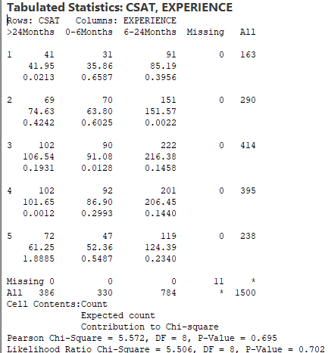
Validation Test for X’s Improvement
Minitab Output of Chi Square Test for Y and X
Interpretation:
There is no impact of “Experience” on CSAT score.
Proprietary and Highly Confidential. 2020 Pursullence Global Business Solutions. All Rights Reserved
Notes:
Hint: Apply appropriate test for other X’s to validate the result. Print the test output here and write appropriate interpretation using p-value.

Slide 97
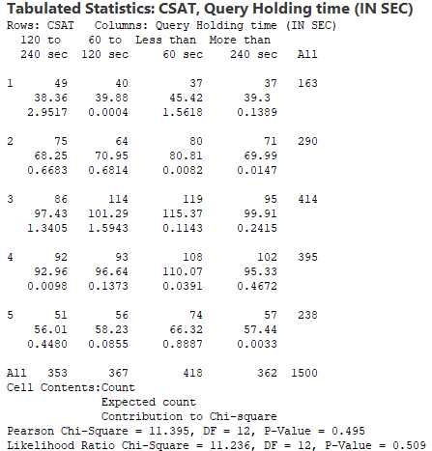
Validation Test for X’s Improvement
Minitab Output of Chi Square Test for Y and X
Interpretation:
There is no impact of “Query Holding Time (IN SEC)” on CSAT score.
Proprietary and Highly Confidential. 2020 Pursullence Global Business Solutions. All Rights Reserved
Notes:
Hint: Apply appropriate test for other X’s to validate the result. Print the test output here and write appropriate interpretation using p-value.

Slide 98
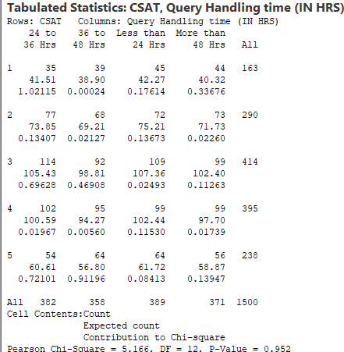
Validation Test for X’s Improvement
Minitab Output of Chi Square Test for Y and X
Interpretation:
There is no impact of “Query Holding Time (IN HRS)” on CSAT score
Proprietary and Highly Confidential. 2020 Pursullence Global Business Solutions. All Rights Reserved
Notes:
Hint: Apply appropriate test for other X’s to validate the result. Print the test output here and write appropriate interpretation using p-value.

Slide 99
Validation Test for Improvement Summary
SR. NO. | Y | X | TEST | P-VALUE | INTERPRETATION
1 | CSAT | TYPES OF TASK COMPLEXITY | CHI SQUARE TEST | 0.000 | Since p-value is < 0.05, we reject null hypothesis. Hence, There is a Impact of “Types of Task Complexity” On CSAT.
2 | CSAT | EXPERIENCE | CHI SQUARE TEST | 0.702 | Since p-value is > 0.05, we fail to reject null hypothesis. Hence, There is no Impact of “Experience” On CSAT.
3 | CSAT | QUERY HOLDING TIME(IN SEC) | CHI SQUARE TEST | 0.509 | Since p-value is > 0.05, we fail to reject null hypothesis. Hence, There is no Impact of “Query Holding Time(IN SEC)” On CSAT.
4 | CSAT | QUERY HOLDING TIME(IN HRS) | CHI SQUARE TEST | 0.952 | Since p-value is > 0.05, we fail to reject null hypothesis. Hence, There is no Impact of “Query Holding Time(IN HRS)” On CSAT.
Proprietary and Highly Confidential. 2020 Pursullence Global Business Solutions. All Rights Reserved
Notes:
Hint: Fill the table and write appropriate interpretation using p-value.

Slide 100
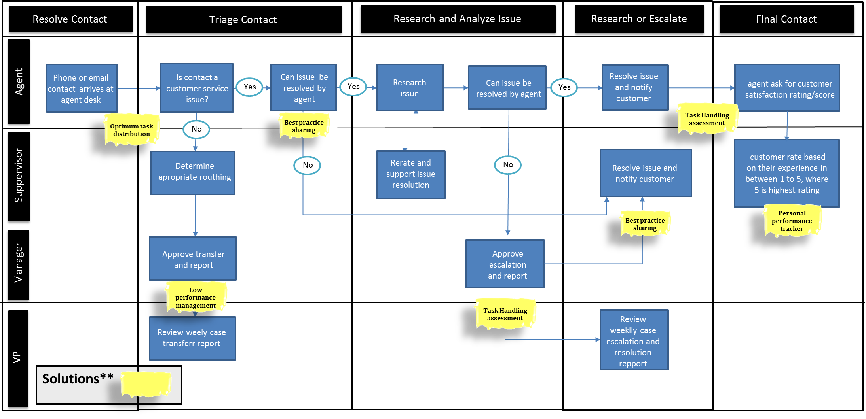
Updated Process Map
Proprietary and Highly Confidential. 2020 Pursullence Global Business Solutions. All Rights Reserved
Notes:
After implementing the solutions, we need to update the process map.

Slide 101
CONTROL PHASE
Proprietary and Highly Confidential. 2020 Pursullence Global Business Solutions. All Rights Reserved
Notes:
Note: Now, control phase begins from this slide.

Slide 102
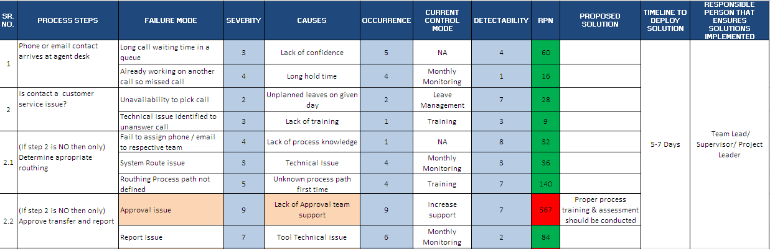
FMEA
Proprietary and Highly Confidential. 2020 Pursullence Global Business Solutions. All Rights Reserved
Notes:
First we will do FMEA in Control phase.
Note: Failure Mode Effect Analysis is done by Pursullence. For your reference excel file is embedded into this slide. To open the file, double click on the excel icon given on the upper right corner.

Slide 103
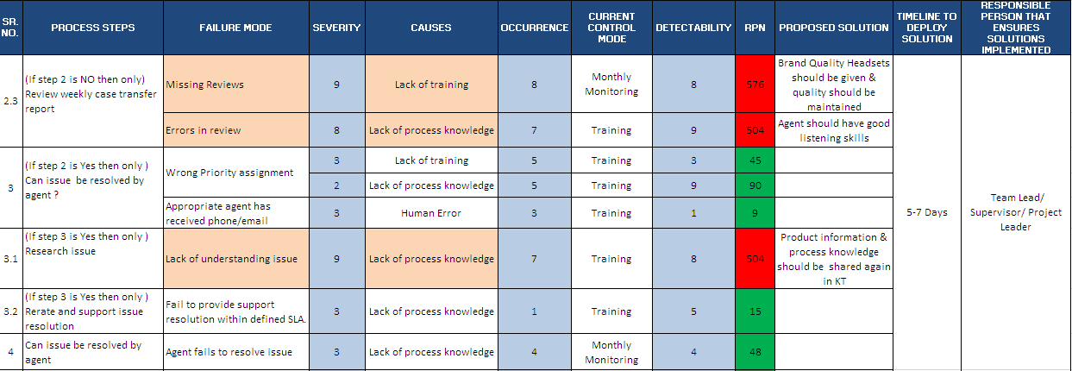
FMEA Continued…
Proprietary and Highly Confidential. 2020 Pursullence Global Business Solutions. All Rights Reserved
Notes:
FMEA Continued…
Note: Failure Mode Effect Analysis is done by Pursullence. For your reference excel file is embedded into this slide. To open the file, double click on the excel icon given on the upper right corner.

Slide 104
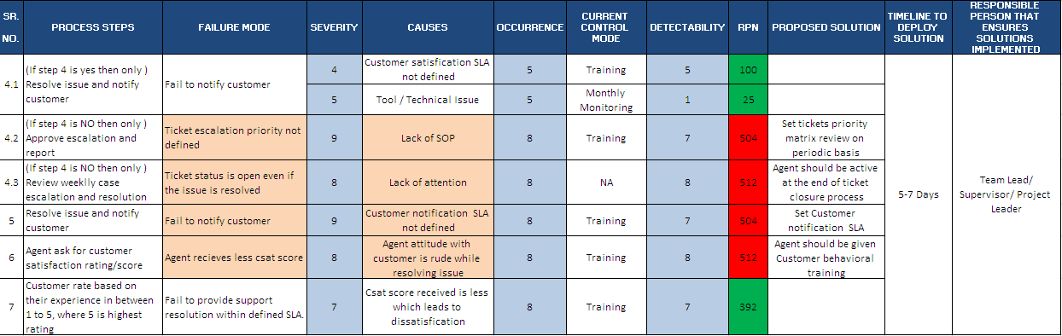
FMEA Continued…
Proprietary and Highly Confidential. 2020 Pursullence Global Business Solutions. All Rights Reserved
Notes:
FMEA Continued…
Note: Failure Mode Effect Analysis is done by Pursullence. For your reference excel file is embedded into this slide. To open the file, double click on the excel icon given on the upper right corner.

Slide 105
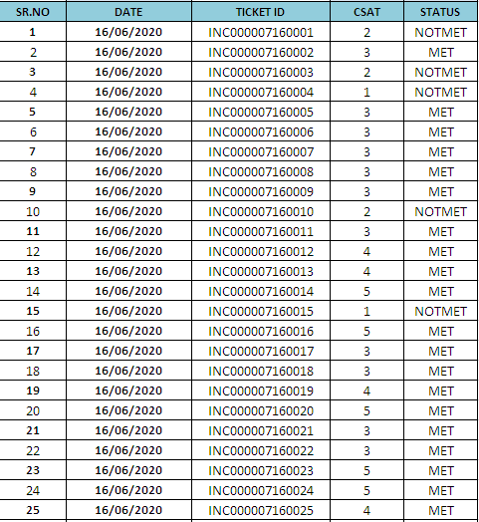
Data Collection for Control Phase
Proprietary and Highly Confidential. 2020 Pursullence Global Business Solutions. All Rights Reserved
Notes:
Control Phase – CSAT Data. Excel file is embedded on this slide.
In this excel, data for CSAT score and status of MET/ NOTMET is given.
Also daily MET count is obtained for each phase and we need this data to compute combined control chart of three phases.

Slide 106
Control Chart – Discrete data
- P chart
Proprietary and Highly Confidential. 2020 Pursullence Global Business Solutions. All Rights Reserved
Notes:
Since, Y i.e. CSAT (MET/NOTMET) is discrete we need to select one of the control chart from discrete control charts. Where we will mainly look at the sample size for each group, whether is varying or constant. In our case we have taken 50 samples on each day, but usually number of queries or tickets generated on each day can be different. So we will select P chart to check whether the process is in control or not.

Slide 107
Control Chart P - Chart
Minitab Path: Stat> Control Charts> Attribute Charts>p . . .
Minitab Session Window output:
Interpretation:
CONTROL limits (not specification limits!) are set at 3 standard deviations from the mean. Any data points beyond these limits are unusual and should be investigated.
In the given control chart every single data point lies between upper and lower control limit expect one data point. Hence we can conclude that significant cause is stable and in control. Identified outlier was investigated, causes were found, solutions were discussed and implemented.
Proprietary and Highly Confidential. 2020 Pursullence Global Business Solutions. All Rights Reserved
Notes:
To draw a P- Chart:
Step 1: Follow the given Minitab path: Stat> Control Charts> Attribute Charts>p .
Step 2: Copy the graphical output (i.e. P – chart) and paste on this slide in the given box.
Step 3: Write the interpretation from the chart.

Slide 108
Validation Test – 2 Proportion Test
Purpose:
To check whether the improvement is sustained in control phase.
Hypothesis
H_{o} : The proportion of CSAT Score in control phase is same as the proportion of CSAT Score in Measure Phase (p₁ = p₂)
H_{a} : The proportion of CSAT Score in control phase is more than the proportion of CSAT Score in Measure Phase (p₁ < p₂)
Proprietary and Highly Confidential. 2020 Pursullence Global Business Solutions. All Rights Reserved
Notes:
Steps to perform 2 proportion test:
Step 1: Write the purpose of doing 2 proportion test for validation (For this, you can refer TAT project)
Step 2: Write Null and Alternate Hypothesis.

Slide 109
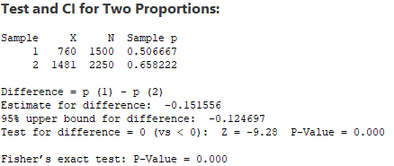
Validation Test – 2 Proportion Test
Minitab Output:
Interpretation: Since the p-value is less than 0.05 (alpha value), so we reject Ho it suggest that the CSAT Score in Improve phase is more than the CSAT Score in Measure Phase.
Conclusion: Since the p- value is less than 0.05 (alpha value), Hence improvement in CSAT Score is accomplished for total population.
Proprietary and Highly Confidential. 2020 Pursullence Global Business Solutions. All Rights Reserved
Notes:
Steps to perform 2 proportion test continued:
Step 3: Follow this Minitab Path to get the output : Stat> Basic Statistics> 2-Proportion test and paste the output in the blank space.
Step 4: Write interpretation and conclusion from the P-value.
Hint:
The expected p-value from the test performed by you should be 0.000

Slide 110
Validation Test – 1 Proportion Test
Purpose:
To validate whether the defined Goal is met, sustained and whether the result is applicable for total population in control phase.
Hypothesis
H_{o} : The proportion of CSAT Score in control phase is same as the target proportion (p = p_{o})
H_{a} : The proportion of CSAT Score in control phase is less than the target proportion (p < p_{o})
Proprietary and Highly Confidential. 2020 Pursullence Global Business Solutions. All Rights Reserved
Notes:
Steps to perform 1 proportion test:
Step 1: Write the purpose of doing one proportion test for validation (For this, you can refer TAT project)
Step 2: Write Null and Alternate Hypothesis.

Slide 111
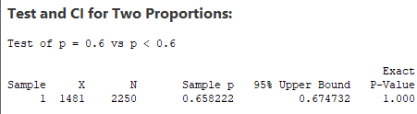
Validation Test – 1 Proportion Test
Minitab Output:
Interpretation: Since the p-value is greater than 0.05 (alpha value), we fail to reject null hypothesis and hence, the proportion of CSAT Score in control phase is same as the target proportion.
Conclusion: Since p-value is greater 0.05 (alpha value), we can conclude that we have sustained with the target of 60% in control phase .
Proprietary and Highly Confidential. 2020 Pursullence Global Business Solutions. All Rights Reserved
Notes:
Steps to perform 1 proportion test continued:
Step 3: Follow this Minitab Path to get the output : Stat> Basic Statistics> 1-Proportion test and paste the output in the blank space.
Step 4: Write interpretation and conclusion from the P-value.
Hint:
In control phase for 1 proportion test use 0.60 as hypothesized value.
The expected p-value from the test performed by you should be 1.000

Slide 112
Capability Analysis of Control Phase
Summary Table
DEFECTIVE DEFINITION | CSAT Score < 3
TOTAL UNITS ( HINT: Take count of CSAT data from control phase) | 2250
TOTAL OPPORTUNITIES (HINT: Here total units & opportunities are same) | 2250
DEFECTIVE ( HINT: How many defectives from CSAT data in control phase are not meeting target <3 CSAT score.) | 769
DEFECTS/DEFECTIVES PER OPPORTUNITIES (HINT: Using DPO formula calculate DPO value) | 0.34177
DEFECTIVES PER MILLION OPPORTUNITIES ( HINT: Using DPMO formula calculate value ) | 341777.777
LONG TERM SIGMA VALUE (ZLT) (HINT: Use formula :- normsinv( 1- DPO) | 0.40761
SHORT TERM SIGMA VALUE (ZST) (HINT: N/A) | NA
Proprietary and Highly Confidential. 2020 Pursullence Global Business Solutions. All Rights Reserved
Notes:
Hint:-
Refer to the formulas provided in measure phase & find the appropriate values of parameters of capability analysis.
2) Capability Analysis: Solutions for Capability analysis are displayed in hint section.
Defective Definition - CSAT Score <3
Total Units - 2250
Total Opportunities - 2250
Defective - 769
Defects/Total Opportunities - 0.341777778
Defectives Per Million Opportunities – 341777.778
LONG TERM SIGMA VALUE (ZLT) = normsinv ( 1- DPO) i.e. normsinv( 1-0.341777778) = 0.41

Slide 113
Phase-wise Sigma Value Comparison
Summarized Graph
PHASE | LONG TERM SIGMA VALUE | AVG
MEASURE | 0.0167 | 0.3141
IMPROVE | 0.518 | 0.3141
CONTROL | 0.4076 | 0.3141
Interpretation: If we observe the graph, the long term sigma value was 0.0167 in Measure phase, it improved to 0.518 in improve phase and got stable in control phase at 0.4076. So, there is an improvement observed in long term sigma value from measure phase to control phase.
Proprietary and Highly Confidential. 2020 Pursullence Global Business Solutions. All Rights Reserved
Notes:
Here, you have to compute sigma value for each phase (i.e. for Measure, Improve & Control) and draw a simple bar chart with average line to compare phase-wise sigma value.
Steps to draw a bar chart for Phase-wise comparison of Sigma Value (Long Term):
First step is copy or write the sigma value for measure and improve phase in the table given on this slide and these values you have obtained previously.
Second is write sigma value for control which is been obtained in the control phase itself.
And once we have sigma values for three phases, then compute average sigma value of these three and write it in the third column in all the three cells.
In excel draw a simple bar graph with average line.
Last step is, write interpretation from the graph.
Note: For interpretation refer previous project of TAT Reduction.

Slide 114
Individual Chart for Combined (Measure, Improve, Control) Performance of Y
Minitab Path: Stat> Control Charts> Attribute Charts > P . . .
Proprietary and Highly Confidential. 2020 Pursullence Global Business Solutions. All Rights Reserved
Notes:
Now, we want to compare the performance of Y (CSAT Score) throughout the phases using control chart. And as Y is discrete and sample size is varying we will use P chart here also.
On this slide Minitab path is provided to draw combined p chart for Measure, Improve and Control Phase. Combined chart is given by Pursullence.

Slide 115
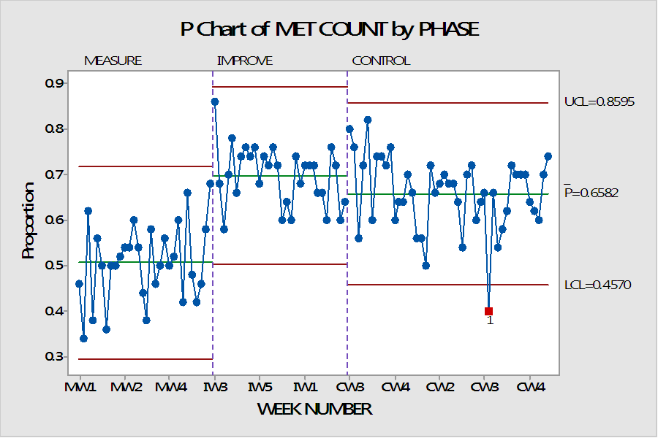
Combined Individual Chart for Performance of Y
Minitab Session Window output:
Interpretation: In measure phase the process is in statistical control. But CSAT score was low. In improve phase the process is within control limits and CSAT Met count also increased.
Proprietary and Highly Confidential. 2020 Pursullence Global Business Solutions. All Rights Reserved
Notes:
Combined chart is given by Pursullence.

Slide 116
Monitoring Plan
MONITORING PLAN
WHAT TO MONITOR (Y) | WHAT IS NON COMPLIANCE ( If performance is less/more than target) | WHO SHOULD MONITOR | WHAT IS FREQUENCY OF MONITIRING | WHO SHOULD APPROVE | WHAT IS THE FREQUENCY OF APPROVAL | WHAT NEED TO SEE IF NON COMPLIANCE (CAUSES) | IS CAUSE (X)MACHINE BASED (Y/N) | IF YES, WHAT IS A TARGET OF X | IS TARGET FOR MACHINE BASED X MET ?
Daily avg CSAT score per query | If CSAT Score of any query is less than 3 that is non compliance (Need Investigation) | Team Lead/Supervisor/ Project Leader | Daily | Manager | Weekly | 1. TYPES OF TASK COMPLEXITY | NA | NA | NA
 |  |  |  |  |  | 2. EXPERIENCE/ TENURE | NA | NA | NA
 |  |  |  |  |  | 3. QUERY HOLDING TIME (IN SEC) | NA | NA | NA
 |  |  |  |  |  | 4. QUERY HANDLING TIME (IN HRS) | NA | NA | NA
 |  |  |  |  |  | 5. AVERAGE TASKS HANDLING PER DAY | NA | NA | NA
 |  |  |  |  |  | 6. % UNPLANNED LEAVES ON GIVEN DAY | NA | NA | NA
Proprietary and Highly Confidential. 2020 Pursullence Global Business Solutions. All Rights Reserved
Notes:
Monitoring plan is given by Pursullence.
Excel file is also embedded here for your reference.

Slide 117
Response Plan
RESPONSE PLAN
Causes | IF ANSWER IS NO, FOR QUESTION "IS CAUSE (X)MACHINE BASED (Y/N)" AND FOR QUESTION "IS TARGET FOR MACHINE BASED X MET (Y/N)" THEN SOLUTIONS REFINED | TIMELINE TO DEPLOY SOLUTION | RESPONSIBLE PERSON THAT ENSURES SOLUTIONS IMPLEMENTED | APPROVAL AUTHORITY
1. TYPES OF TASK COMPLEXITY | 1. Analyze past 3 months task distribution and increase high complex task distribution to experienced members by 20-30% over next3 weeks. | 7-10 Days
2. EXPERIENCE/ TENURE | 1. Arrange a meeting with mid experienced staff and discuss their challenges and best practices with them and incorporate adequate best practices 2. Develop an improvement plan for consistent low performers | 7-10 Days | Team Lead/ Supervisor/ Project Leader | Manager
3. QUERY HOLDING TIME (IN SEC) | 1. Develop personal performance tracker for bottom 20% performers. | 7-10 Days
Proprietary and Highly Confidential. 2020 Pursullence Global Business Solutions. All Rights Reserved
Notes:
Complete the Response plan in the Excel sheet embedded into this slide.
Steps to create response plan:
Step 1. Write solution(s) in front of causes for which we have obtained solutions in Improve phase.
Step 2. Write timeline to deploy solutions (Refer previous project)
Step 3. Write Responsible person that ensures solutions are implemented or not. (Refer previous project)
Step 4. Write Approval Authority(Refer previous project)

Slide 118
Response Plan Continued…
RESPONSE PLAN
Causes | IF ANSWER IS NO, FOR QUESTION "IS CAUSE (X)MACHINE BASED (Y/N)" AND FOR QUESTION "IS TARGET FOR MACHINE BASED X MET (Y/N)" THEN SOLUTIONS REFINED | TIMELINE TO DEPLOY SOLUTION | RESPONSIBLE PERSON THAT ENSURES SOLUTIONS IMPLEMENTED | APPROVAL AUTHORITY
4. QUERY HANDLING TIME (IN HRS) | 1. Arrange monthly training program. 2. Develop personal performance tracker for bottom 20% performers. | 7-10 Days
5. AVERAGE TASKS HANDLING PER DAY | 1. Ensure task switching reduces by 20-30% at freshers level by ensuring minimal task switching for freshers as low as 1 task a day | 7-10 Days | Team Lead/ Supervisor/ Project Leader | Manager
6. % UNPLANNED LEAVES ON GIVEN DAY | 1. Analyze unplanned leaves pattern, restructure appraisal policy with negative points on unplanned leaves. 2. Encourage team planned leaves before team. | 7-10 Days
Proprietary and Highly Confidential. 2020 Pursullence Global Business Solutions. All Rights Reserved
Notes:
Response Plan Continued…

Slide 119
Project Sign off & Closure
Receiving approval from Process Owner, MBB and Finance Manager for project completion.
We computed Long term sigma, as short term sigma not applicable here. Every single month for next 3 months it will be responsibility of supervisor to share that data with GB.
The responsibility of GB is to calculate sigma value for every month. GB need to investigate If that value is less than long term sigma and if it is less and If it happens consistently for 3 months then BB need to get involve and fix it.
Submission of LSS GB project master file, cause and solutions log and relevant documents to responsible person from operation.
Proprietary and Highly Confidential. 2020 Pursullence Global Business Solutions. All Rights Reserved
Notes:
Project Sign off & Closure is given by Pursullence.
This is the last procedure of project closure.

Slide 120
HERE, WE ARE DONE WITH ALL THE FIVE PHASES OF DMAIC AND OUR CSAT PROJECT.
‘CONGRATULATIONS’ TO YOU ALL FOR COMPLETING THIS PROJECT.
THANK YOU!!!
Proprietary and Highly Confidential. 2020 Pursullence Global Business Solutions. All Rights Reserved
Notes:
CSAT Project completed.

